Slide 1
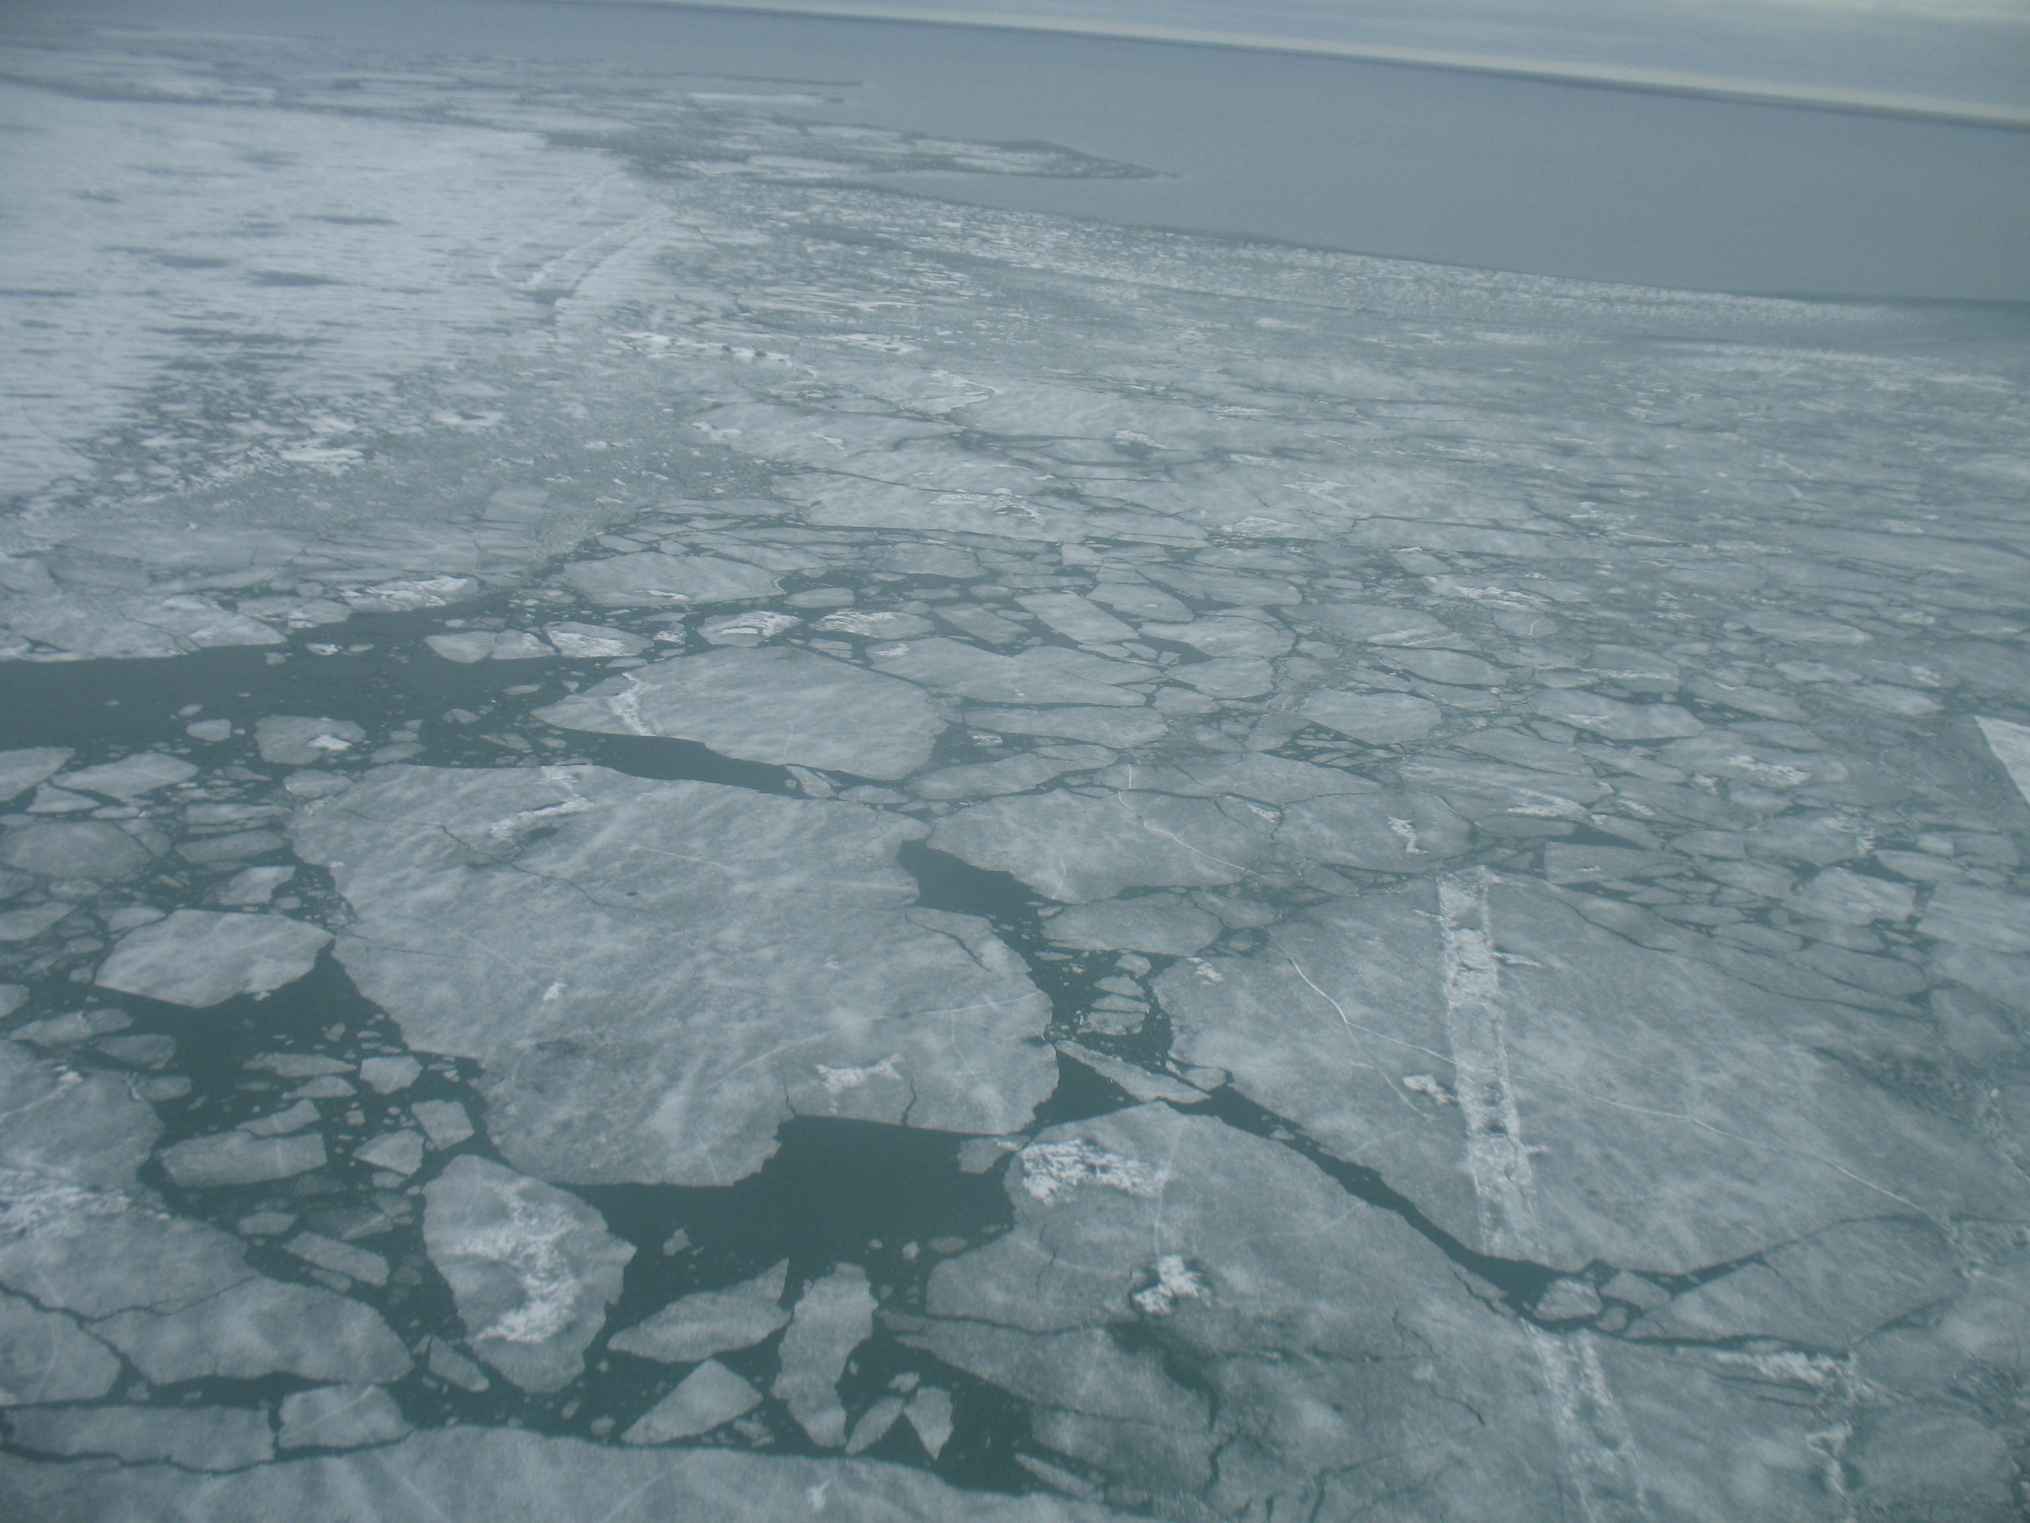
The Hydrology and Ice-cover of Teshekpuk Lake
in a Changing Arctic Climate
Christopher D. Arp
Water and Environmental Research Center,
University of Alaska Fairbanks
Benjamin M. Jones
Alaska Science Center, U.S. Geological Survey
Geophysical Institute, University of Alaska, Fairbanks

Slide 2
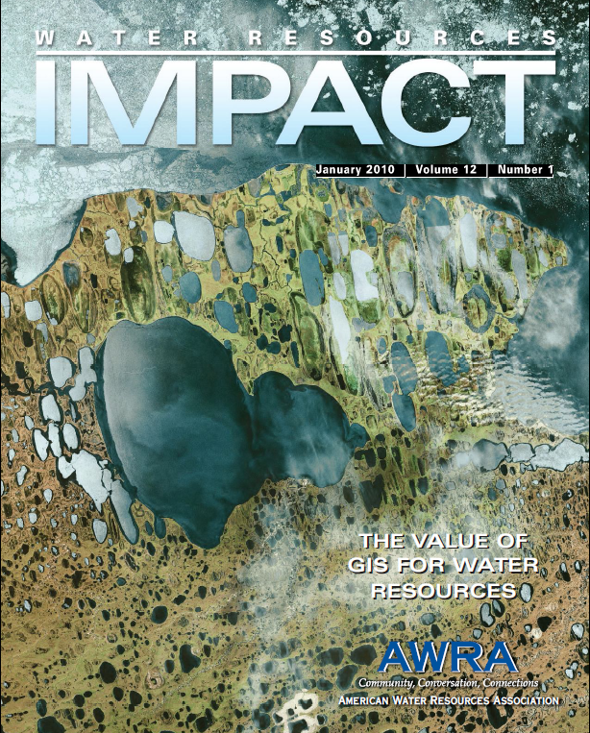
Notes:
This talk concerns Teshekpuk Lake, which is located on the Arctic Coastal Plain between Barrow and Prudhoe Bay. It gained national prominence here because if was featured on the cover of AWRA publication, probably because its big and interesting looking from space. It’s 3rd largest in Alaska and though its origin is uncertain, could be the largest thermokarst lake in the world. Because of its large size it likely has a dominant influence on regional climate, landscape, and wildlife; though the nature of these influences are not well understood. Also because of its large size and northern position by the Beaufort Sea it likely is the last lake in the state to become ice free in most years and thus may be a good indicator of climate changes.

Slide 3
Talk Outline
Natural history of Teshekpuk Lake
Thermokarst lake hydrology & ice dynamics
Methods for reconstructing ice records
Teshekpuk Lake ice cover history
Climate conditions leading short and long open-water seasons
Impacts on hydrology and ecology
Notes:
Here’s an outline of talk. First I’ll give some background on the lake and region, describe a related study that we completed on lake ice and hydrology for smaller lakes in region, describe methods for reconstructing ice out and ice on timing, present results for Teshekpuk and describe climate conditions related to early and late ice-out and ice-on, and discuss how these patterns and trends relate to hydrology and ecology of the lake and region.

Slide 4
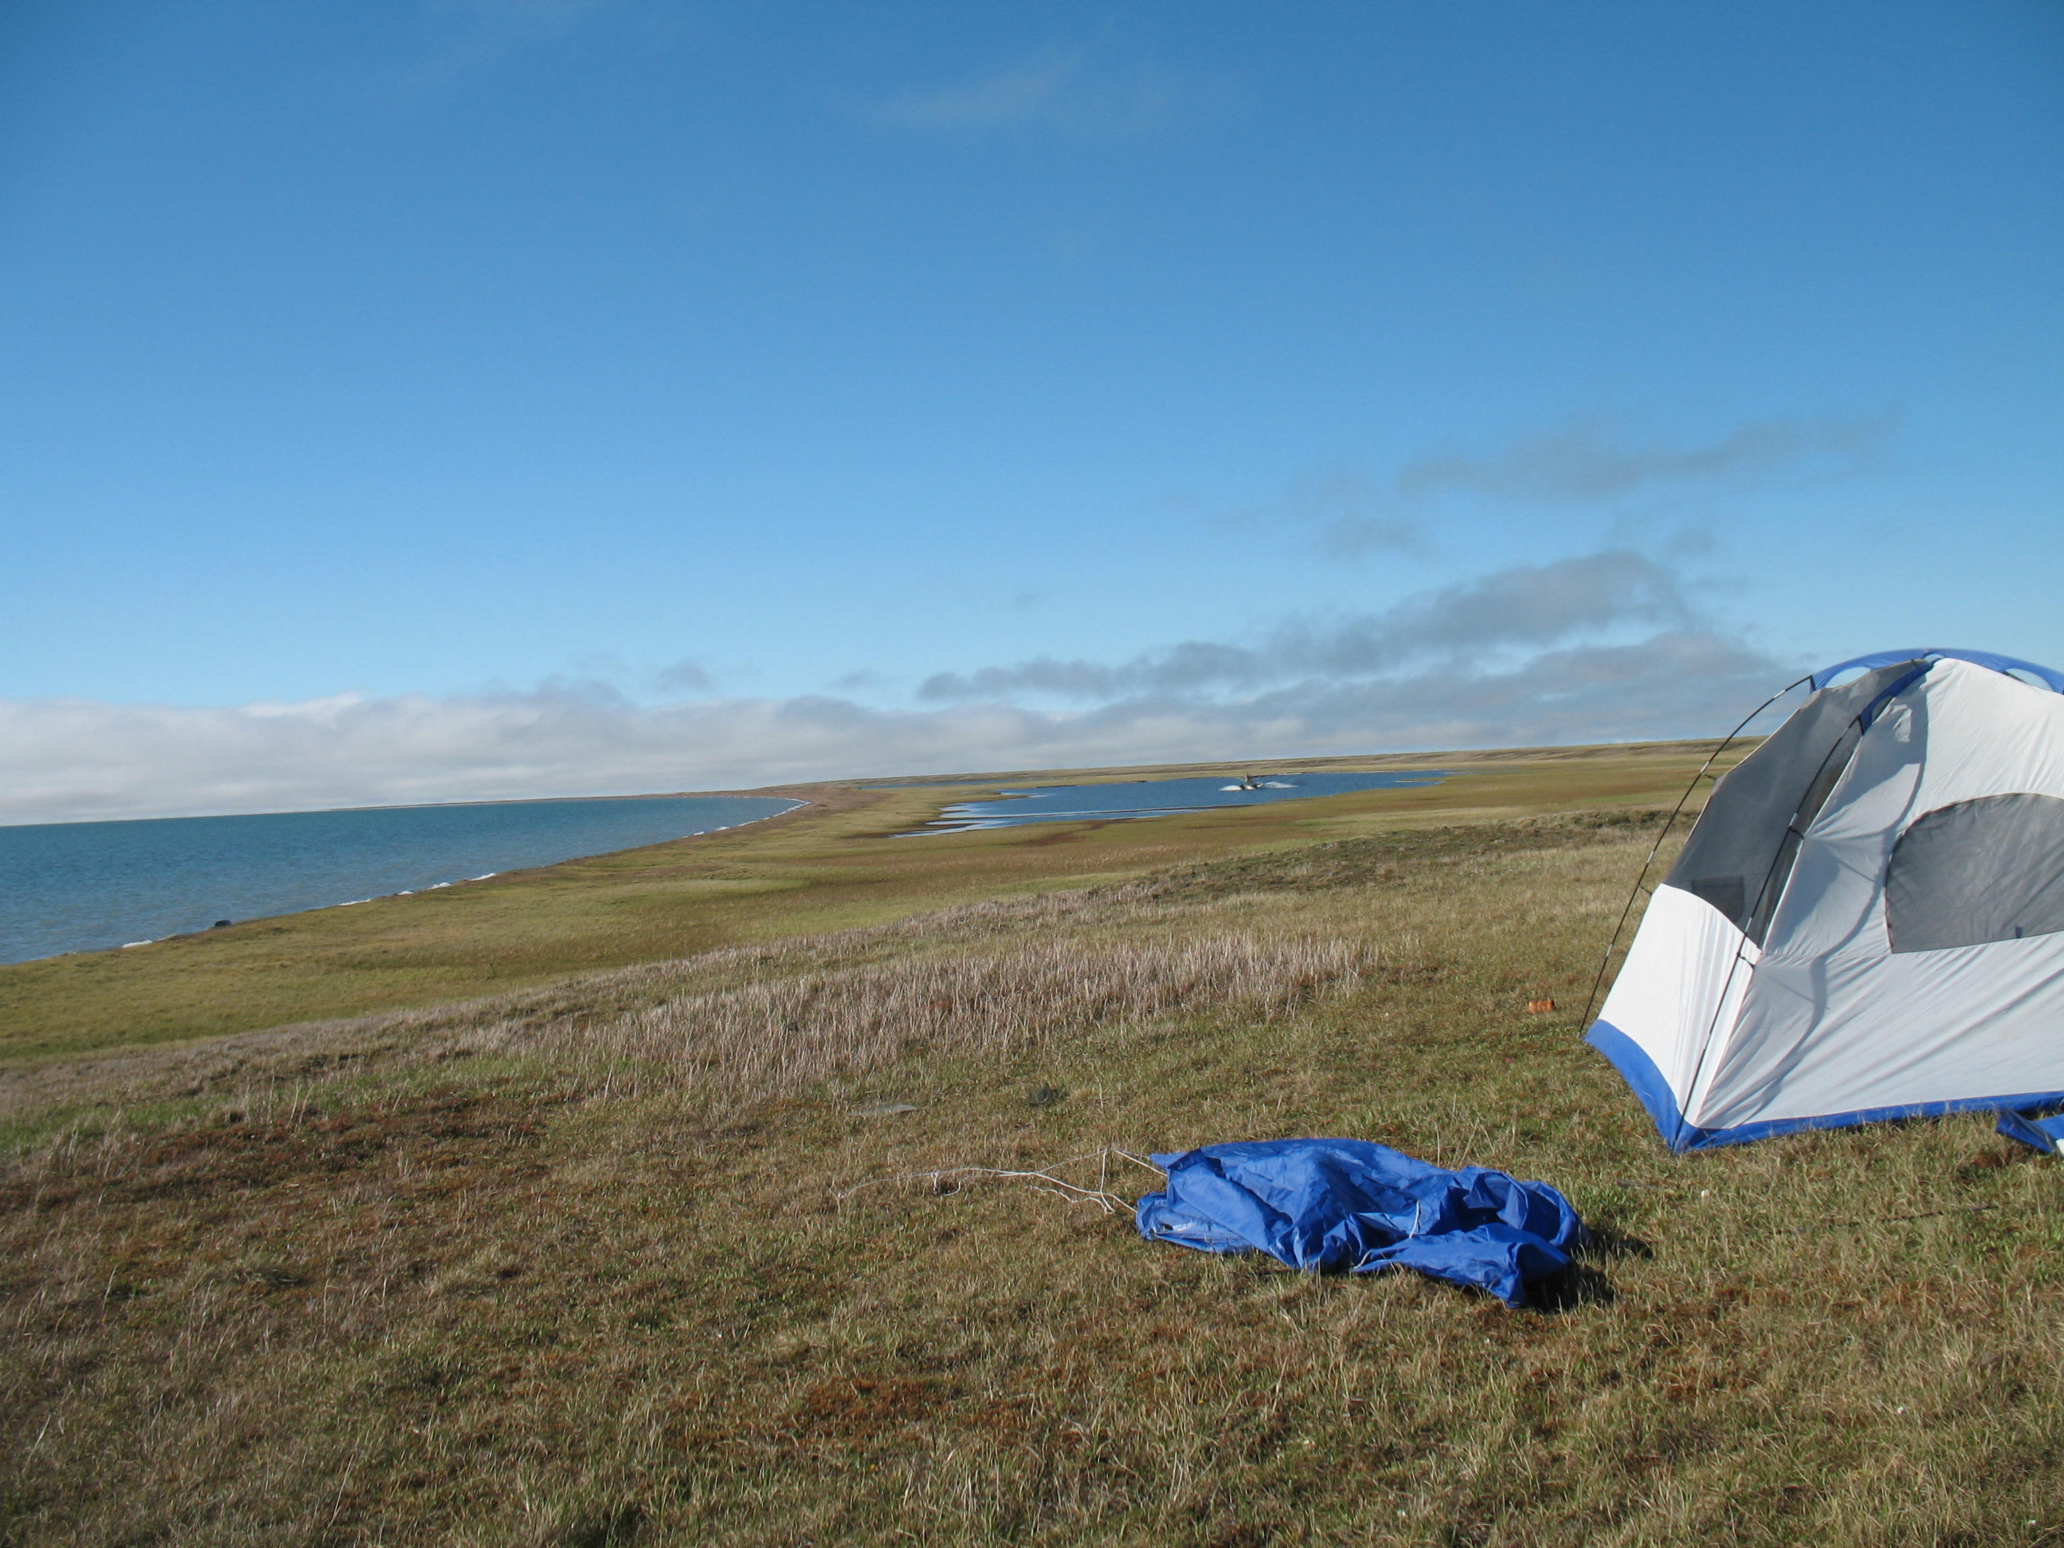
Natural History of Teshekpuk Lake
Notes:
I’ll start by providing some background information about the lake and surrrounding region.

Slide 5
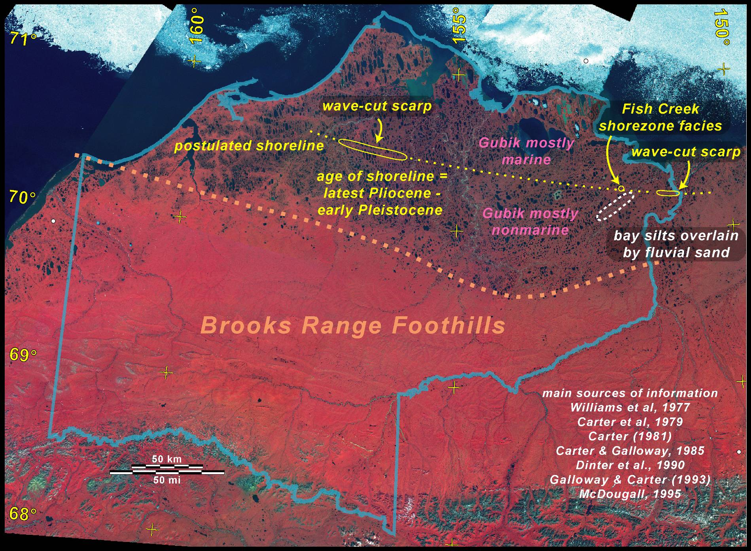

Notes:
In terms of management, Teshekpuk Lake is within the National Petroleum Reserve – Alaska (boundary here) and the TLSA. Its longer term history is strongly tied to climate change and associated marine transgressions when it was likely part of a lagoon system most recently with the Simpsonian transgression 58-76 kya that forms northern shoreline when sea levels where 7-10 m above present seal level and Pelukian transgression 120 kya that forms southern shoreline when sea levels were 10-13 m higher than present. Area north of Teshekpuk has very ice rich glaciolaucustrine silty soils and south of Teshekpuk also ice rich but overlain by eolian sand sheet from Pliestocene with varying activity during Holocene.

Slide 6
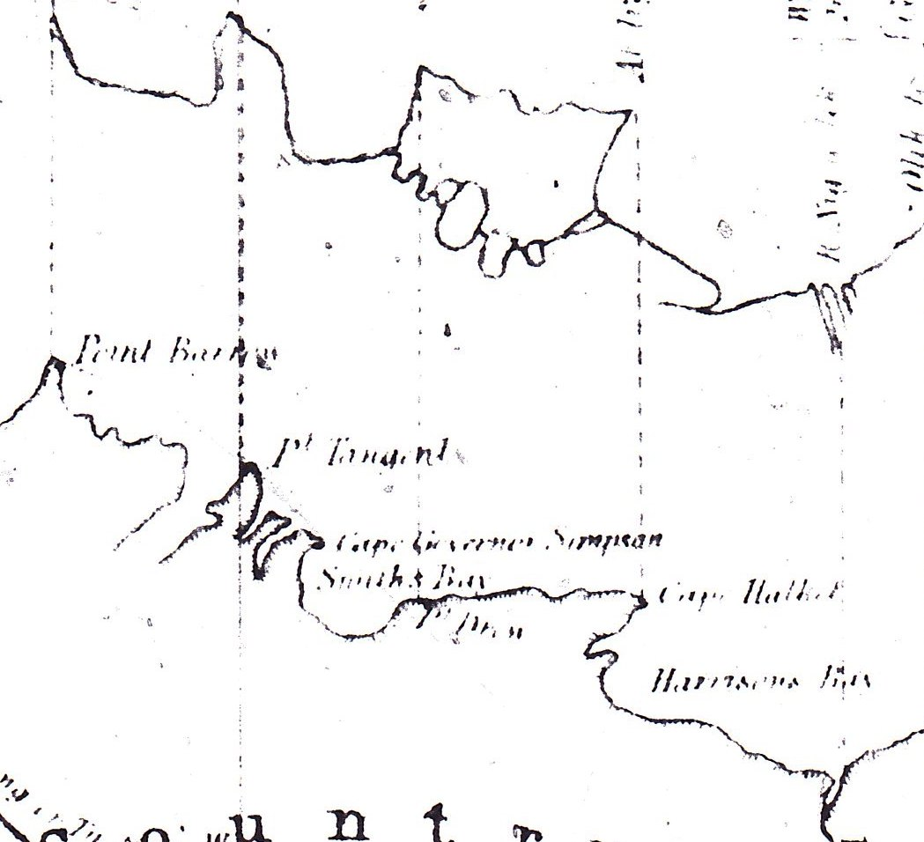
Native map dating to early-1800s
Teshekpuk
Dashed lines show agreement between native map and explorers map
Early explorers map dating to 1830s
*note Tesh as separate lakes
Notes:
There has been much interest in the evolution of Teshekpuk Lake basin. These two maps (SOURCE?) from 1800 show general form of coastline below and above suggest a series of separate basins connected from Ikpikpuk River to Kogru River, where these basins are now coalesced and drain to the west. My co-author on this Ben Jones has been working to date the drained lake basins that Teshekpuk eroded into to gain better chronology of longterm lake expansion rates and lake cores have been recently collected here by UAF and various geophysical surveys have recently been conducted by USGS in Woods Hole to gain a better understanding of geologic structure and lake and regional chronology.

Slide 7
North Lake/Derksen Basin
August 1955
19 July 1979
18 July 2002
16 July 2007
Weller and Derksen 1979 Arctic
Jones et al 2009 Environmental Management
Notes:
A recent example of lake tapping and drainage by Teshekpuk Lake is shown here, which was first identified by Weller and Derksen and described in greater detail by Jones et al. In this case Teshekpuk Lake was responsible for erosion into North Lake shoreline causing its drainage and conversion to important wetland habitat. The cabin where we base many of our studies is very near here and the importance of recently drained lakes to wildlife is very evident from observing abundant and diverse wildlife here.

Slide 8
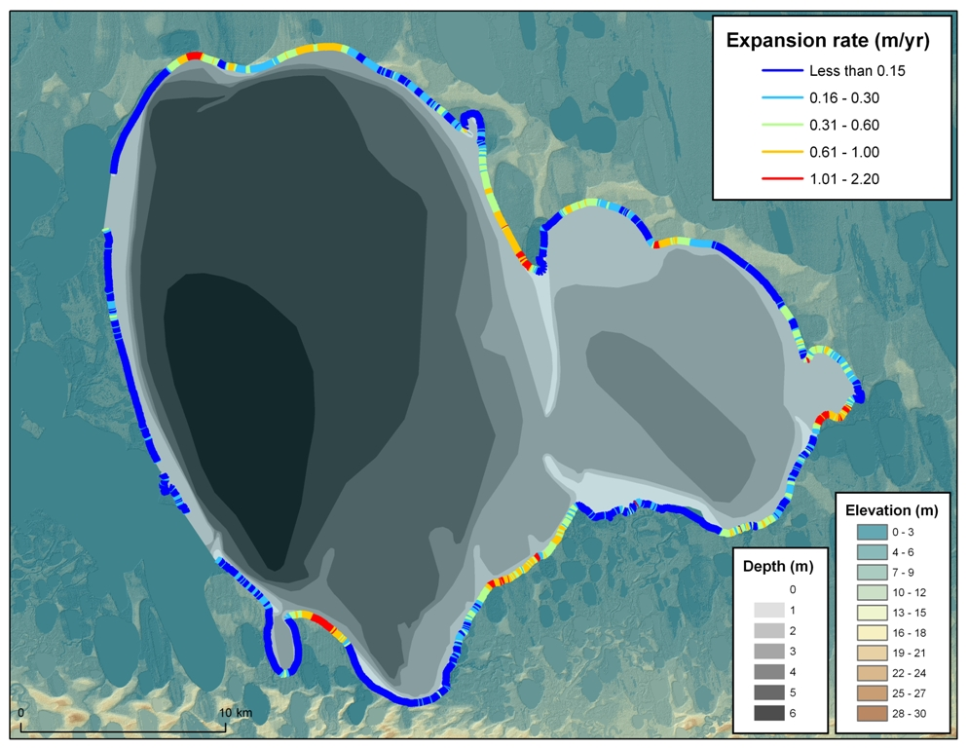
Modern day expansion rates
Notes:
The lake basin is still expanding. This analysis from erosion rates from 1979 to 2002 show rates ranging up to 2-m yr. The resolution of lake bathymetry has improved greatly thank to recent studies of fish communities and also interest in methane release from sediments. Though very large in surface area, it is relatively shallow with maximum depth of about 7 m.

Slide 9
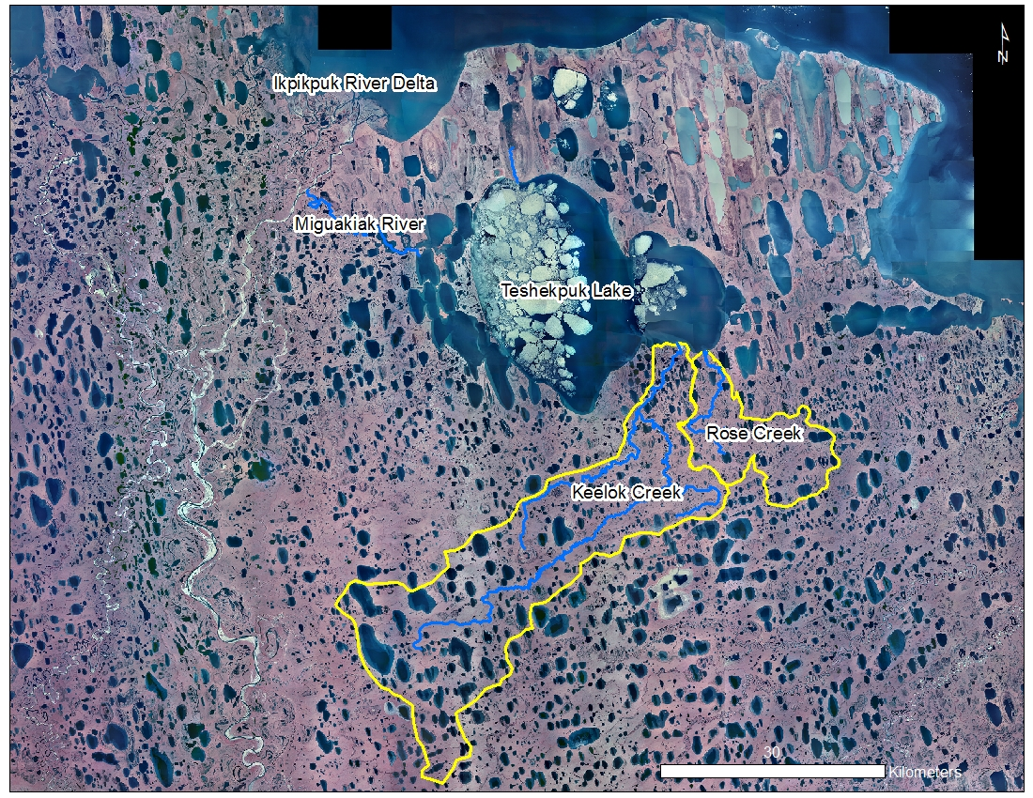
Notes:
The contemporary hydrography of Teshekpuk Lake looks something like this. Only major streams flowing into lake are Keelok and Rose Creeks from south about 1000 km2 and Miguakiak (May-or-ee-ak) River drains through a mosaic of coalesced basins to the west into the Ikipikpuk River Note that major inflows come in to the east basin form a delta, though there is evidence that this used to flow directly to larger western basin. So much of its hydrologic recharge is likely low and directly to its surface, which is a important feature that I’ll try to revisit at end of talk.

Slide 10
Teshekpuk Lake is very fresh!
Specific Conductance ranges from 250 – 350 uS/cm
Arp et al 2011 Polar Biology
Notes:
Also note that its surface sites just above sea level, but it is very fresh water, whereas lakes to northeast at similar low elevation are variably flooded by storm surges or have direct marine connections.

Slide 11
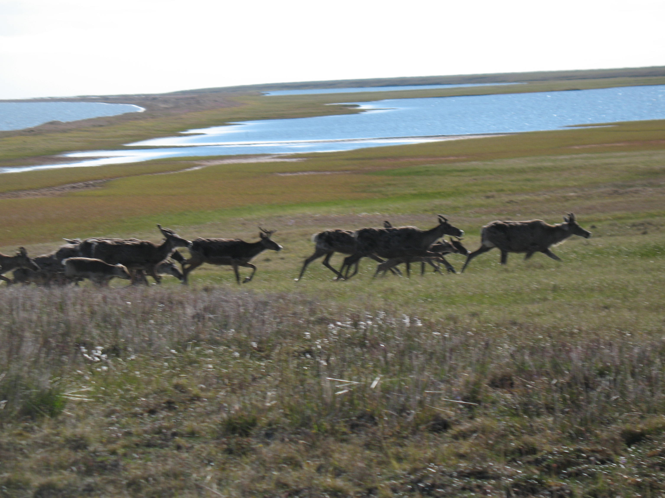
Wildlife - Caribou
Person et al 2007 Arctic
Notes:
Surrounding lands support major wildlife resources with important subsistence value including the Teshekpuk Lake caribou heard that use areas all around the lake for calving in late spring and mosquito relief in summer.

Slide 12
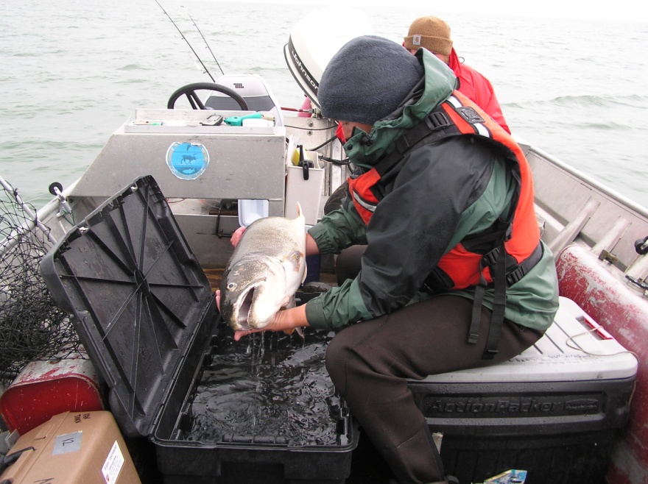
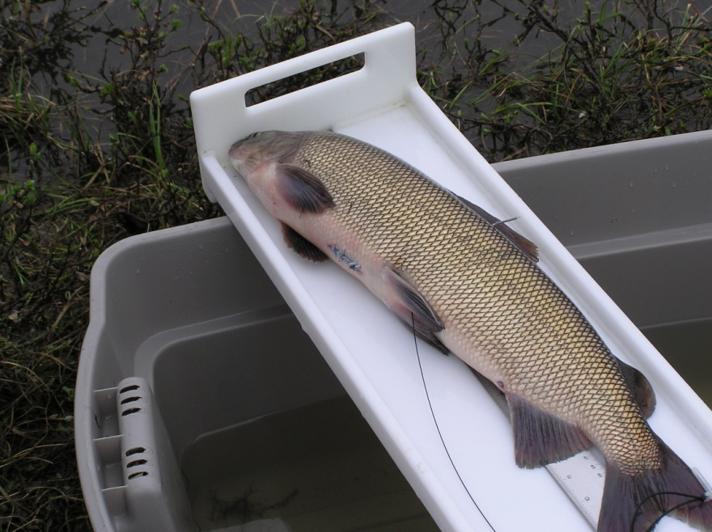
Wildlife - Fish
Species | 1990-92 | 2003-05
Broad whitefish | X | X
Humpback whitefish | X | X
Least cisco | X | X
Round whitefish | X | X
Bering cisco | X | X
Arctic grayling | X | X
Pink salmon | X
Arctic char |  | X
Lake trout |  | X
Burbot | X | X
Northern pike | X | X
Slimy sculpin |  | X
Alaska blackfish |  | X
Threespine stickelback |  | X
Ninespine stickelback | X | X
Teshekpuk lake trout
M. Whitman
Teshekpuk broad whitefish
M. Whitman
Moulton et al 2007
Notes:
Teshekpuk lake supports impressive community of fish including large and very slow growing lake trout. There has been some work done here but still little known about how fish use Teshekpuk Lake and how this use may have changed through it evolution. Also the legend of Teshekpuk lake monster.

Slide 13
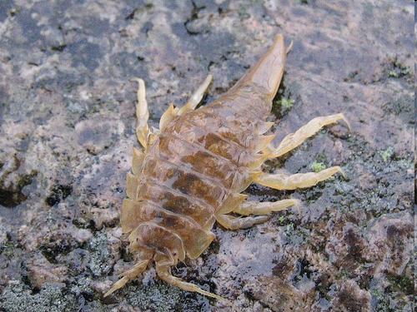
Wildlife - Invertebrates
Mesidotea entomon teshpuki (?)
B. Jones
Notes:
Freshwater Teskekpuk also supports population of Arctic marine isopod Mesidotea entomon that is prevalent along Beaufort Sea coastline. Currently being studied by Sandy Talbot and Roman Dial Jr. at USGS.

Slide 14
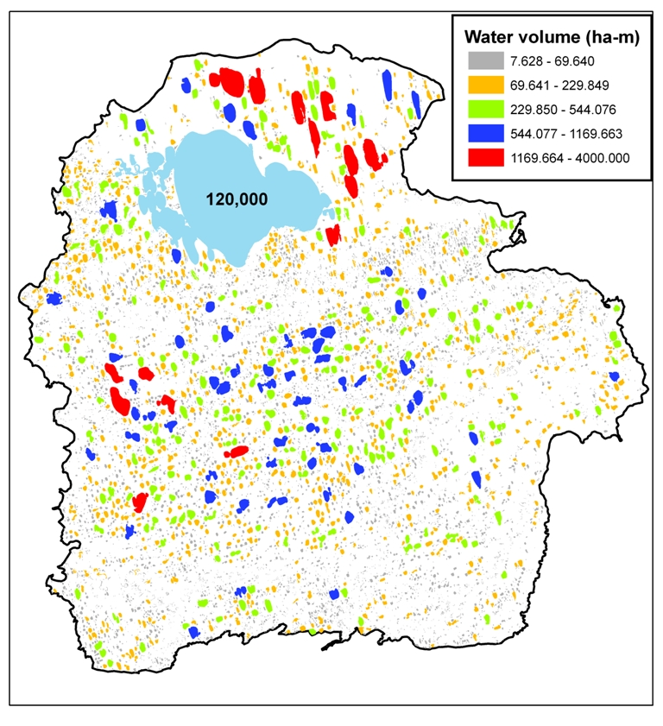
First estimate of lake surface water storage
Based on surface area to volume relationship for three lake types
Lake Type | Total Volume (ha-m) | Percent of Area
Thaw | 98173 | 16.9
Depression | 312951 | 53.9
Riverine | 50023 | 8.6
Teshekpuk | 120000 | 20.6
Notes:
Bottom line, it has a lot of fresh water particularly in the winter. This is a map showing estimates of water volume across lake types in eastern NPRA. Currently we are working to improve such estimates of water availability in lakes, particularly during the winter for ice road planning purposes and to better understand overwinter fish habitat.

Slide 15
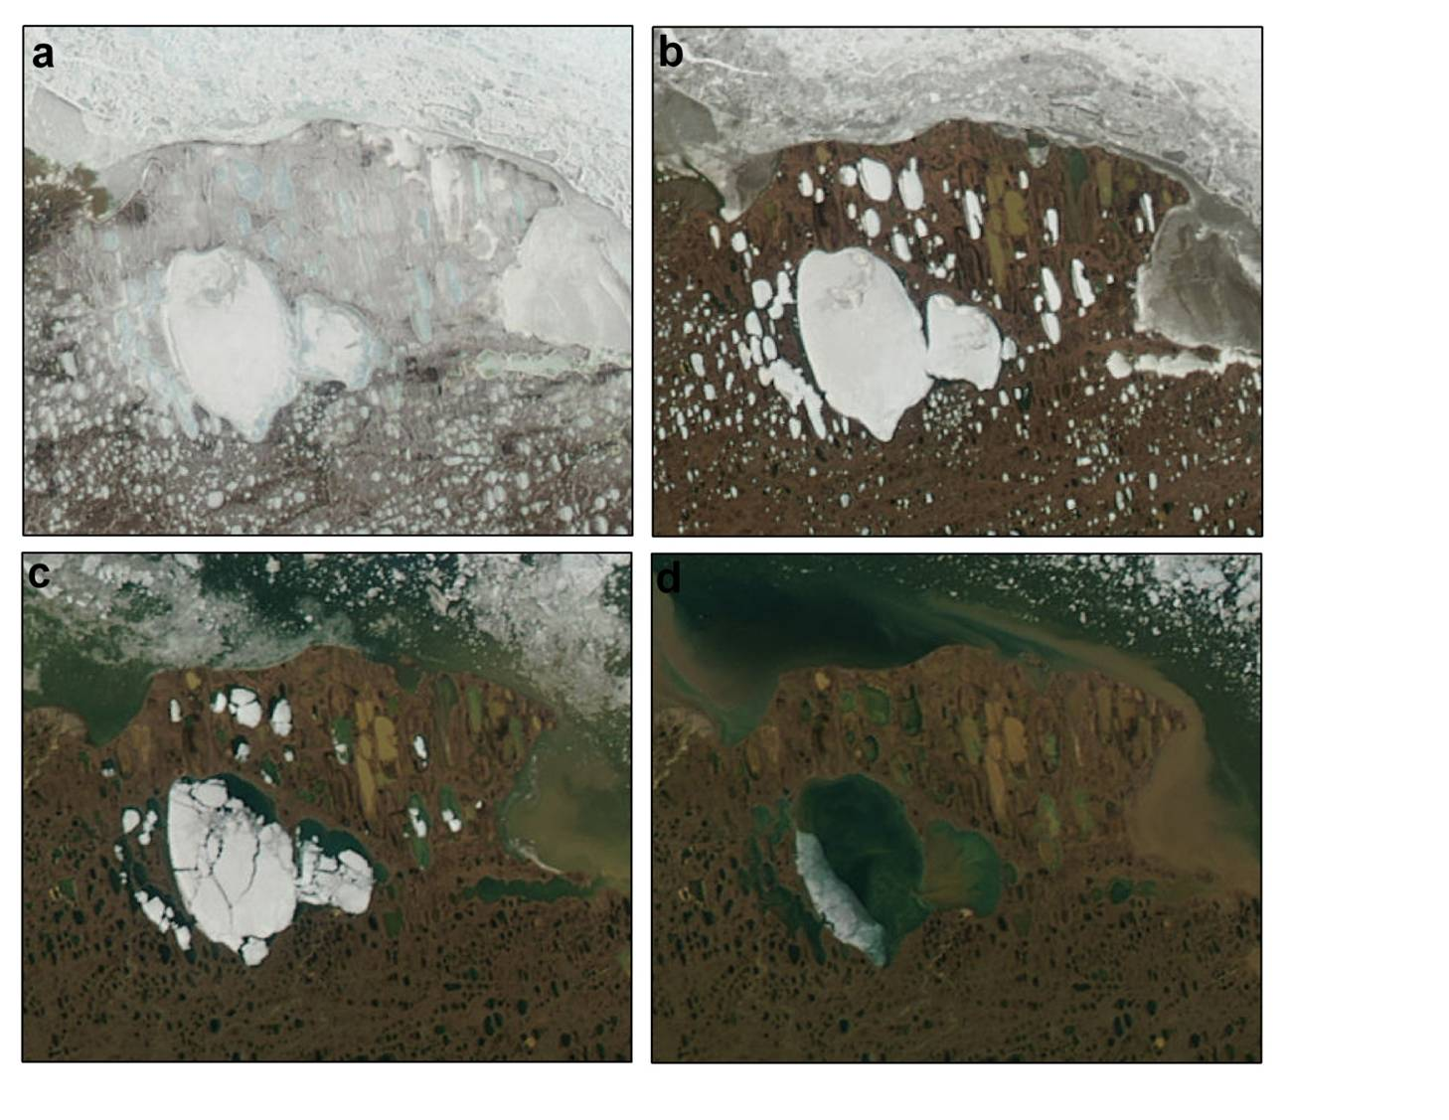
6-June-2007
20-June-2007
5-July-2007
13-July-2007
Notes:
And Teshekpuk maintains ice cover for a long time and this certainly plays a role in its hydrology and ecology. This variable ice out timing is shown hear with all lakes frozen in early June, a set of lakes become ice free in mid June, by early July most lakes are breaking up, and mid July Tesh is mostly ice free as well. Besides just Teshekpuk I’ve become very interested in how this widely varying ice out timing affects habitat availability and productivity on North Slope.

Slide 16
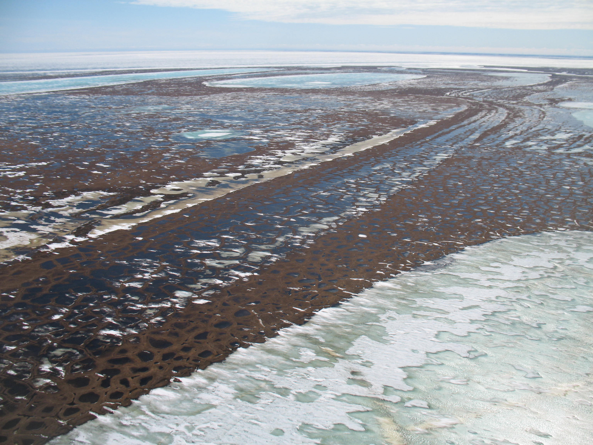
Thermokarst Lake Hydrologic & Ice Regimes
Notes:
So before talking about Teshekpuk I’ll present results from other lakes in area with this pattern of varying ice out timing.

Slide 17
Arctic Lake Change Questions
What are the processes underlying observed changes in lakes across permafrost zones?
What are the relative roles of lake expansion by thermokarst erosion vs. variation in water balance?
Do lakes respond to climate change uniformly within a region?
What is the role of lake bathymetry and ice phenology in geomorphic and hydrologic processes?
Notes:
These are some of the questions we were looking to address in this work.

Slide 18
Notes:
To begin thinking about how the ice cover regime of Teshekpuk Lake affects its hydrology and ecology, I’ll present results from recent study of 13 smaller thermokarst lakes in TLSA, approximately half that freeze solid (grounded ice) and others are deeper than maximum ice thickness of about 1.5-m and have floating ice atop liquid water.
As you can see there are many lakes that fall into both lake ice regimes in TLSA. There’s were mapped with SAR and ground truthed during March and April by drilling holes.

Slide 19
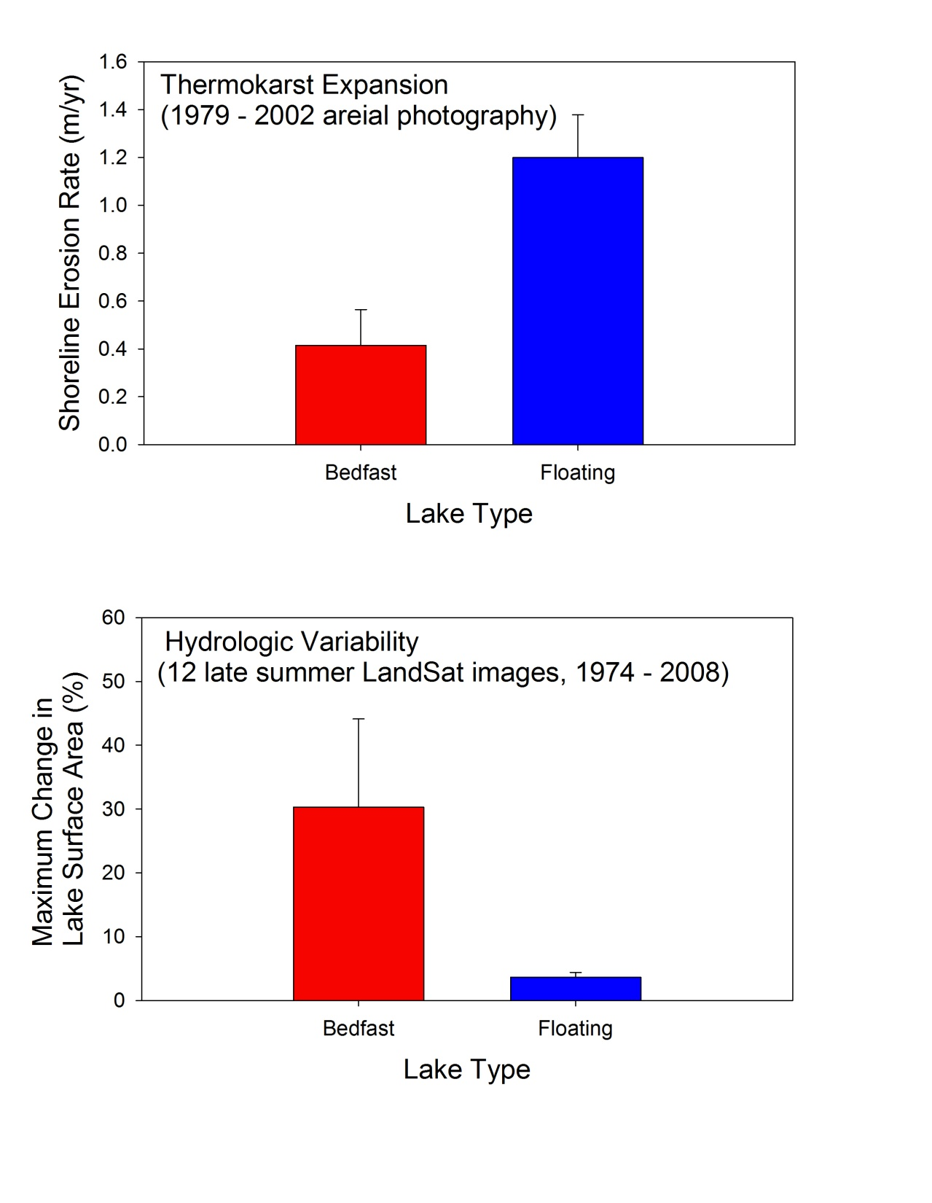
Comparing Lake Change Mechanisms between Grounded-ice and
Floating-ice Lakes
Arp et al 2011 Hydrological Processes
Notes:
We looked at both shoreline erosion and lake expansion using high resolution photography that showed higher rates for deeper lakes with floating ice compared to shallow lakes with bedfast ice. We looked at hydrologic variability using many Landsat images over about 34 year period by correcting for lake expansion and show that the deeper lakes with floating ice had relatively stable surface areas while several shallow lakes varied greatly among years and this could be explained by summer rainfall and evaporation rates.

Slide 20
Divergent
Hydrologic
Behavior between Grounded-ice and
Floating-ice Lakes
Longer open-water period for grounded ice lakes
More positive water balance for floating ice lakes
Potentially different long term water balance in lakes…
…but depends on runoff contributions, lake storage, and outlet discharge
Arp et al 2011 Hydrological Processes
Notes:
So the results of this study suggest that lakes on the coastal plain behave differently depending on their ice regimes where floating ice lakes have open water on average 20-40 days less per summer compared to grounded ice lakes, this creates more positive water balance for floating ice lakes and potentially this can create greatly varying water balance in lakes depending on ice regimes

Slide 21
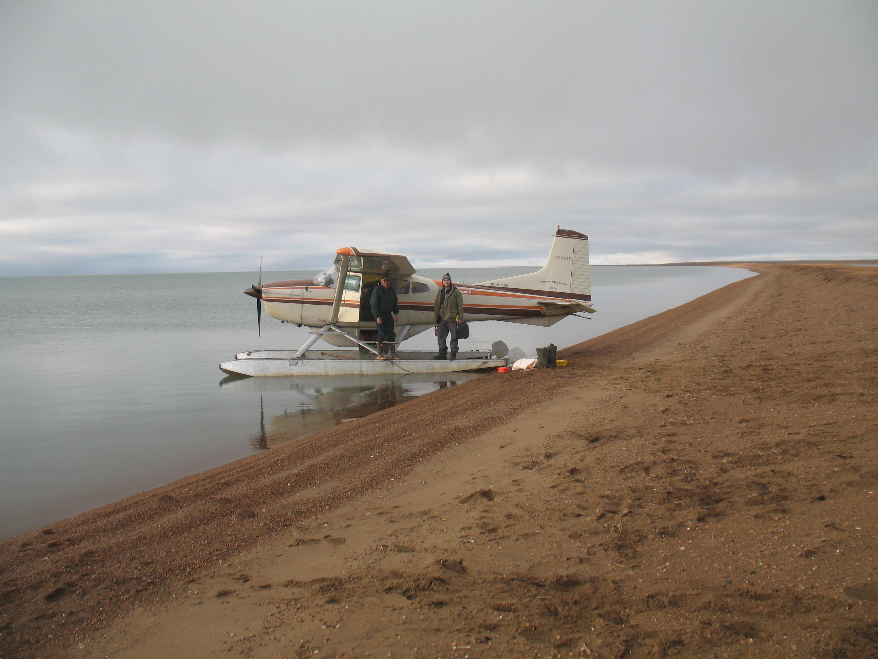
Methods for Reconstructing Ice Regimes
Notes:
So Teshekpuk Lake has even shorter periods of open water than these lakes we just showed and we are interested in reconstructing how this is changed over time and how such change might impact lake hydrology.

Slide 22
Integrated Monitoring, Remote Sensing, and Modeling
Temperature sensors (2007-09) – detect ice out and ice formation (high resolution, short period)
MODIS (2004-08, Arp et al 2010 JAWRA) and Landsat (1974-2009, this study) – bracket ice out and ice formation (low resolution, moderate period)
Ice growth model (modified Stefan equation based on FDD) and ice decay model (Belillo et al 1964 based on TDD) both driven by air temperature from TLSA (1998-2009) and Barrow (1947 – 2009)
Notes:
We used an integrated approach using short term water temperature data, longer term observations to bracket ice out and ice on timing, and simple ice growth and decay models that we calibrated to sensor and RS observations. The combination of these methods provides very robust means of analyzing ice cover regimes, but we aren’t able to use all of these particularly for early period. So I made this graphic to represent my relative level of certainity in our analysis that I’ll present.

Slide 23
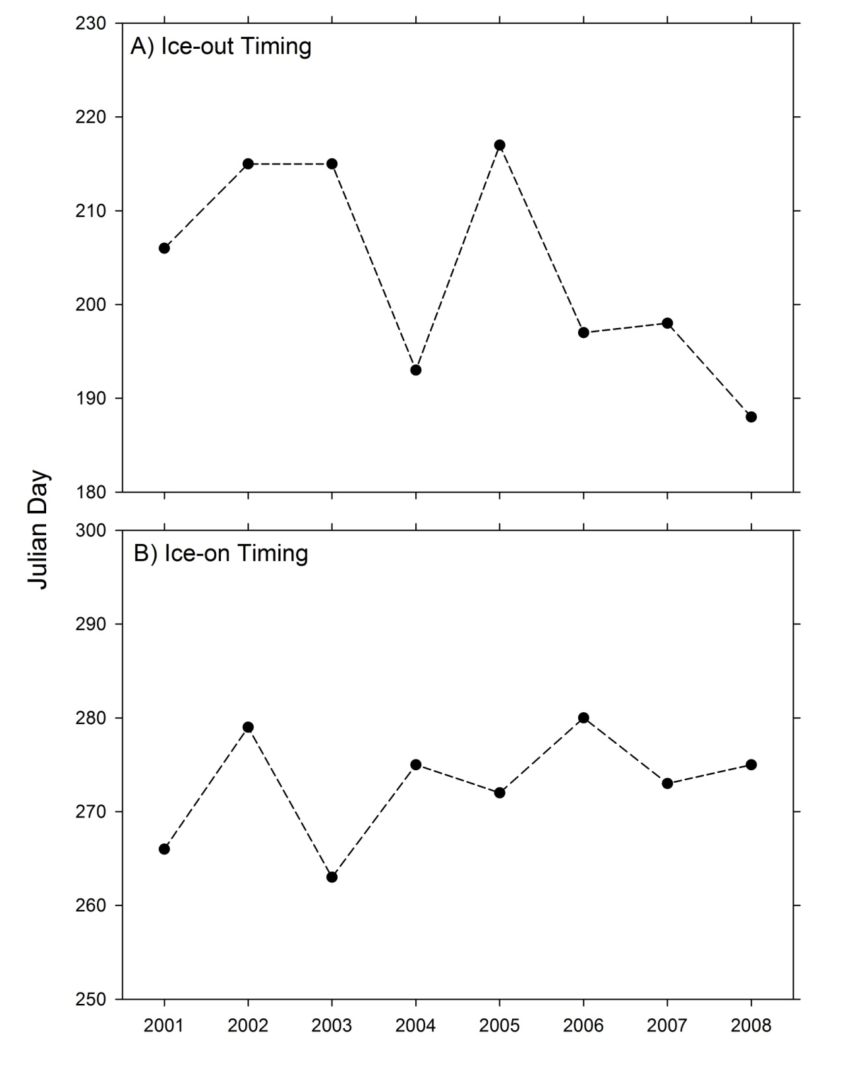
Results from Previous Work and Evaluation of Certainty
Arp et al 2010 JAWRA
Notes:
Here are results where we have greater confidence in accuracy of ice out and ice on timing.

Slide 24
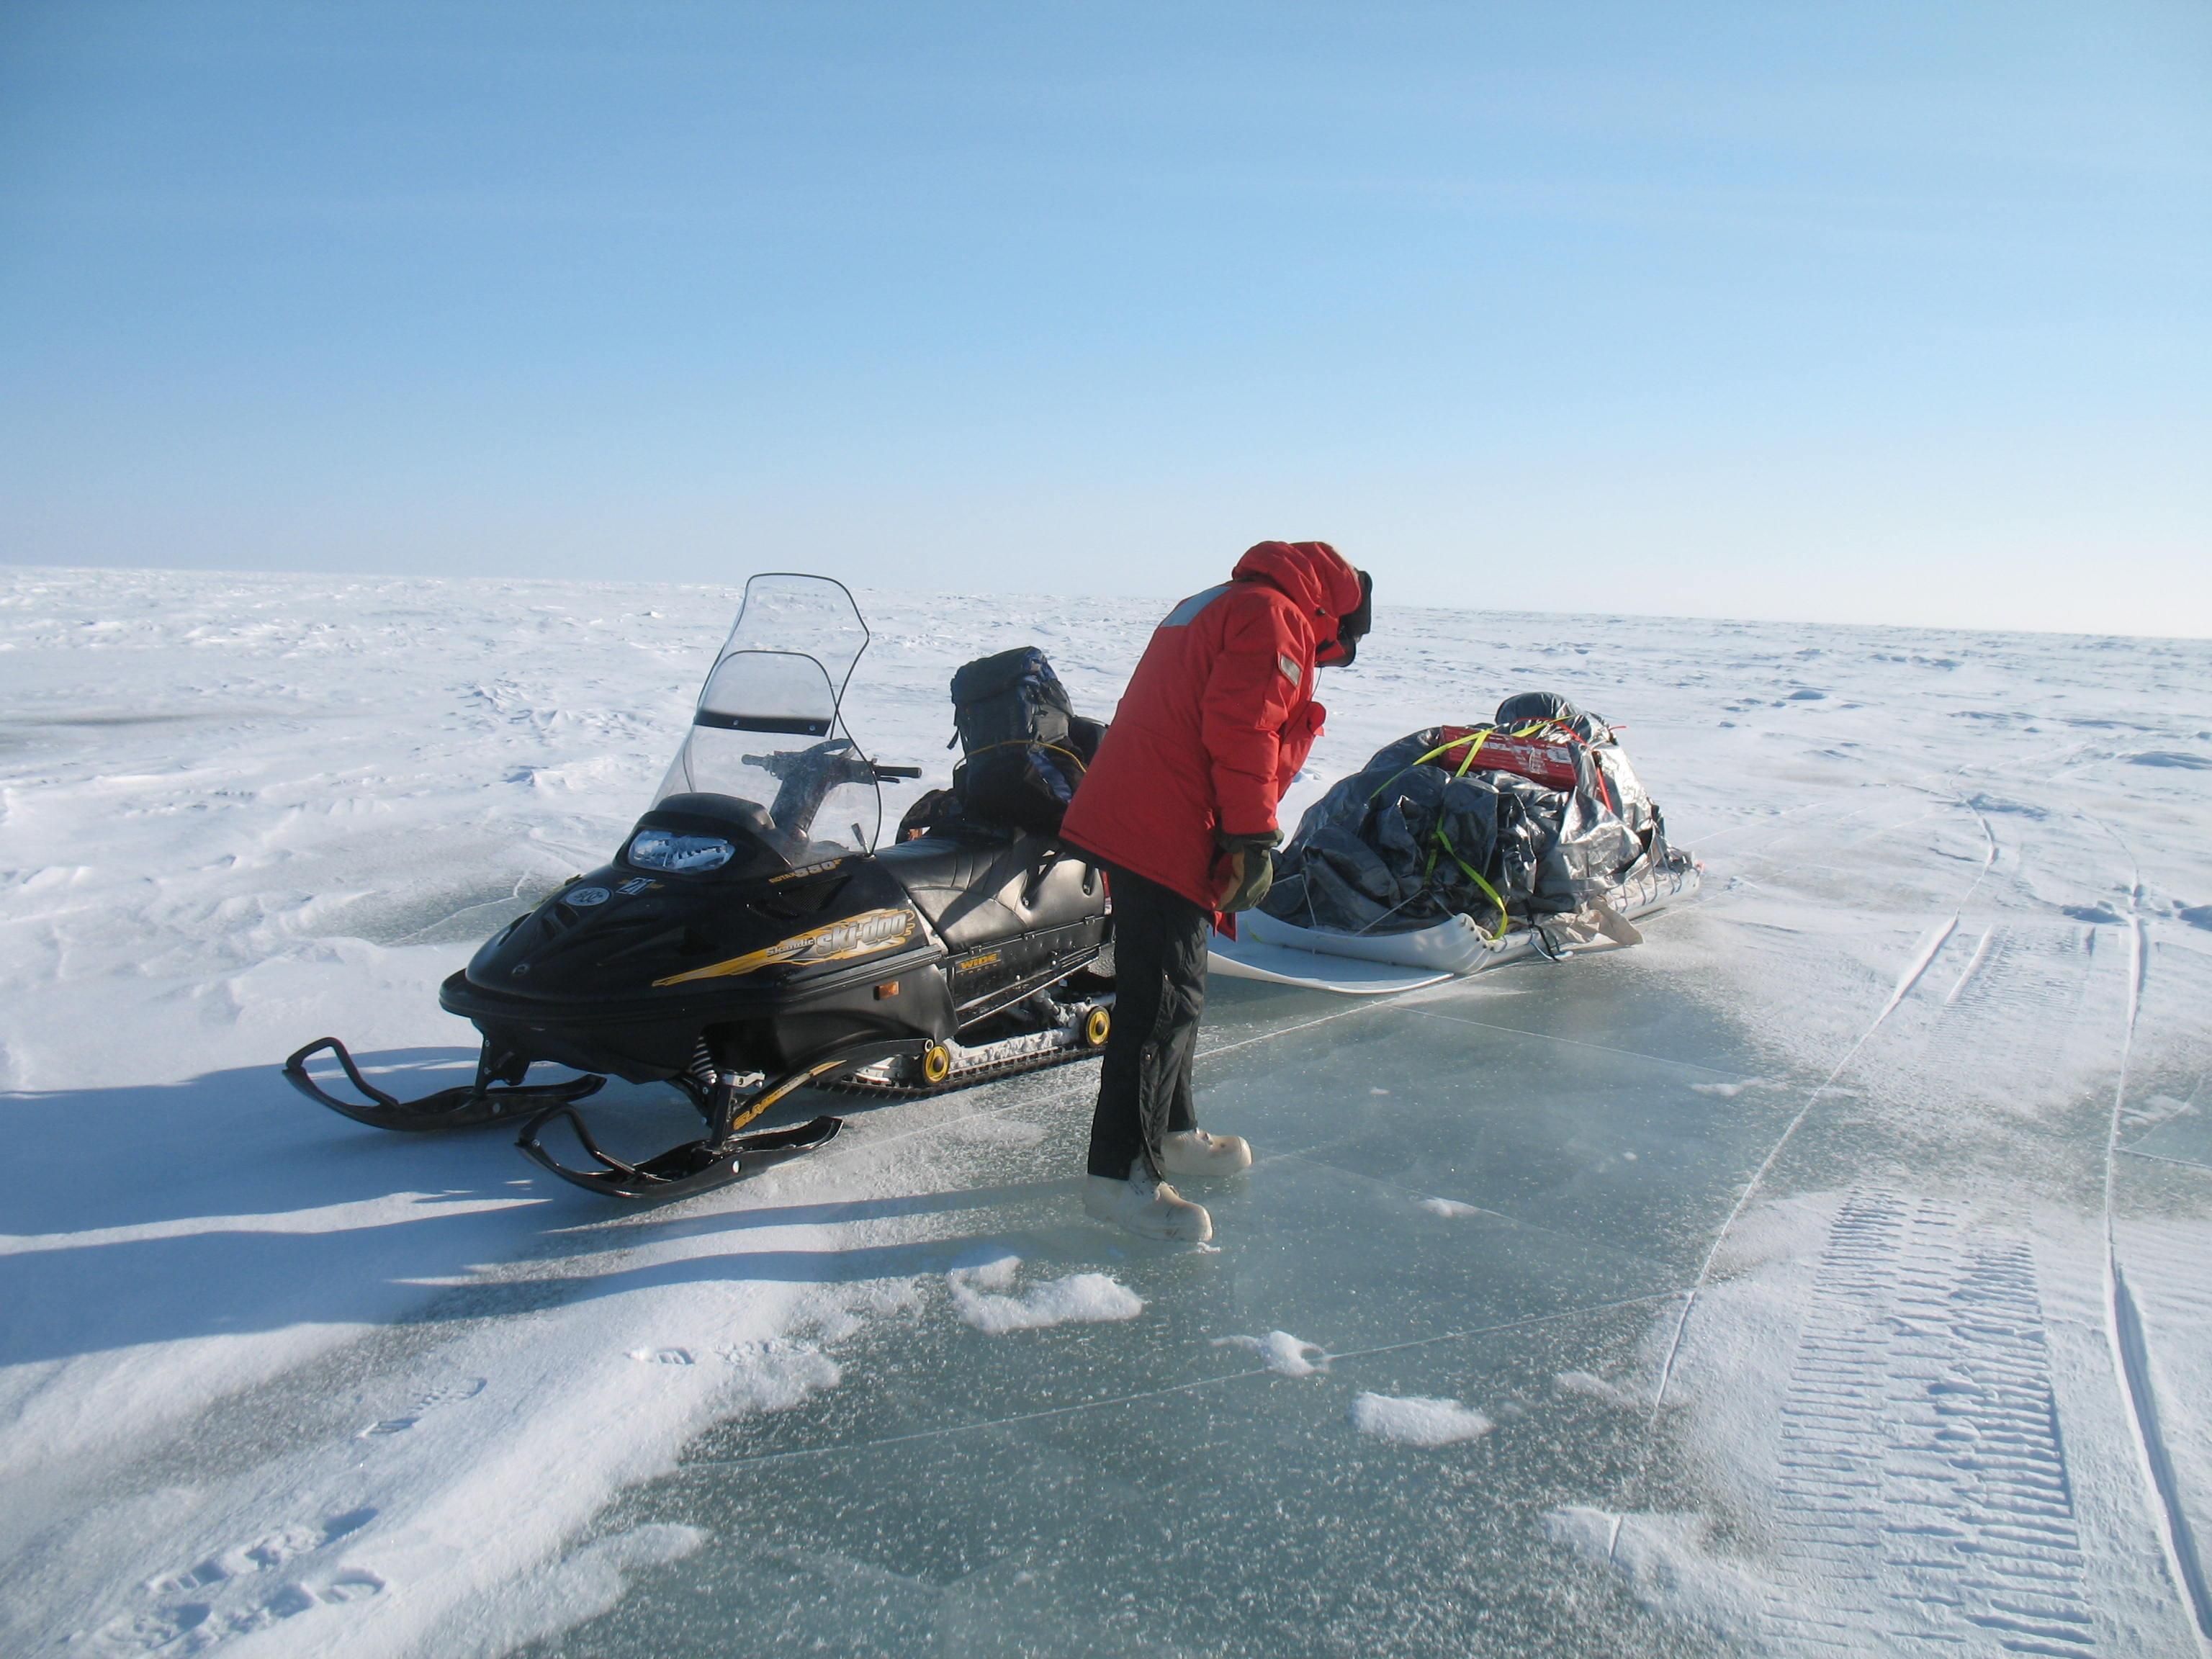
Teshekpuk Lake ice cover history
Notes:
Next I’ll present longer term results on ice cover of Teshekpuk Lake

Slide 25
Ice-out Timing Analysis (1974 – 2009)
Notes:
Here are results of ice-out timing estimates using our modeling approach compared to bracketing from Landsat imagery with the midpoint estimate. Overall the is no bias between observed and modeled, but as you can see there are many discrepencies particularly for earlier period. Both methods show a trend towards ice-out on Teshekpuk Lake

Slide 26
Ice-on Timing Analysis (1974 – 2009)
Notes:
Modeling ice formation timing is much less refined, particular for large lake like Teshekpuk where wind and snowfall can be an important factor for initial ice development. Overall there is little bias between methods, but considerable disagreem in some years and also lack of imagery in many years to provide reasonable bracketing of this process. Like our shorter term analysis from 2001-2008, no trend in ice on is apparent here and this is similar result to studies of lakes throughout northern latitudes.

Slide 27
Ice-out and Ice-on Timing (1947 – 2009)
Perennial Ice Cover…?
Notes:
Using only modeled estimates of ice on and off, we went back to 1947 using Ta data from Barrow. This suggests longterm trend toward earlier ice out of about 0.4 days / year with potentially a step change in mid-80s towards earlier and more interannually consistent ice out timing. Like the shorter record, ice on appears to be variable but with no apparent trend. Interesting thing to note here is that these lines merge for 1956 and 1969 when we estimate that Tesh had perrenial ice cover.

Slide 28
Ice Free Duration (1947 – 2009)
Notes:
Joining these two estimates we get open water duration and time that Teshekpuk interacts with atmosphere. Mainly due to earlier iceout this shows a trend towards longer ice free conditions. Again we estimate that 1956 and 1969 were perennially ice covered. How can we validate this? Maybe by talking to Lake Trout or Teshy. Lake Trout in Tesh are very long lived and maybe this signature would show up in their otoliths. Are Lake Trout in Tesh residents or migratory?

Slide 29
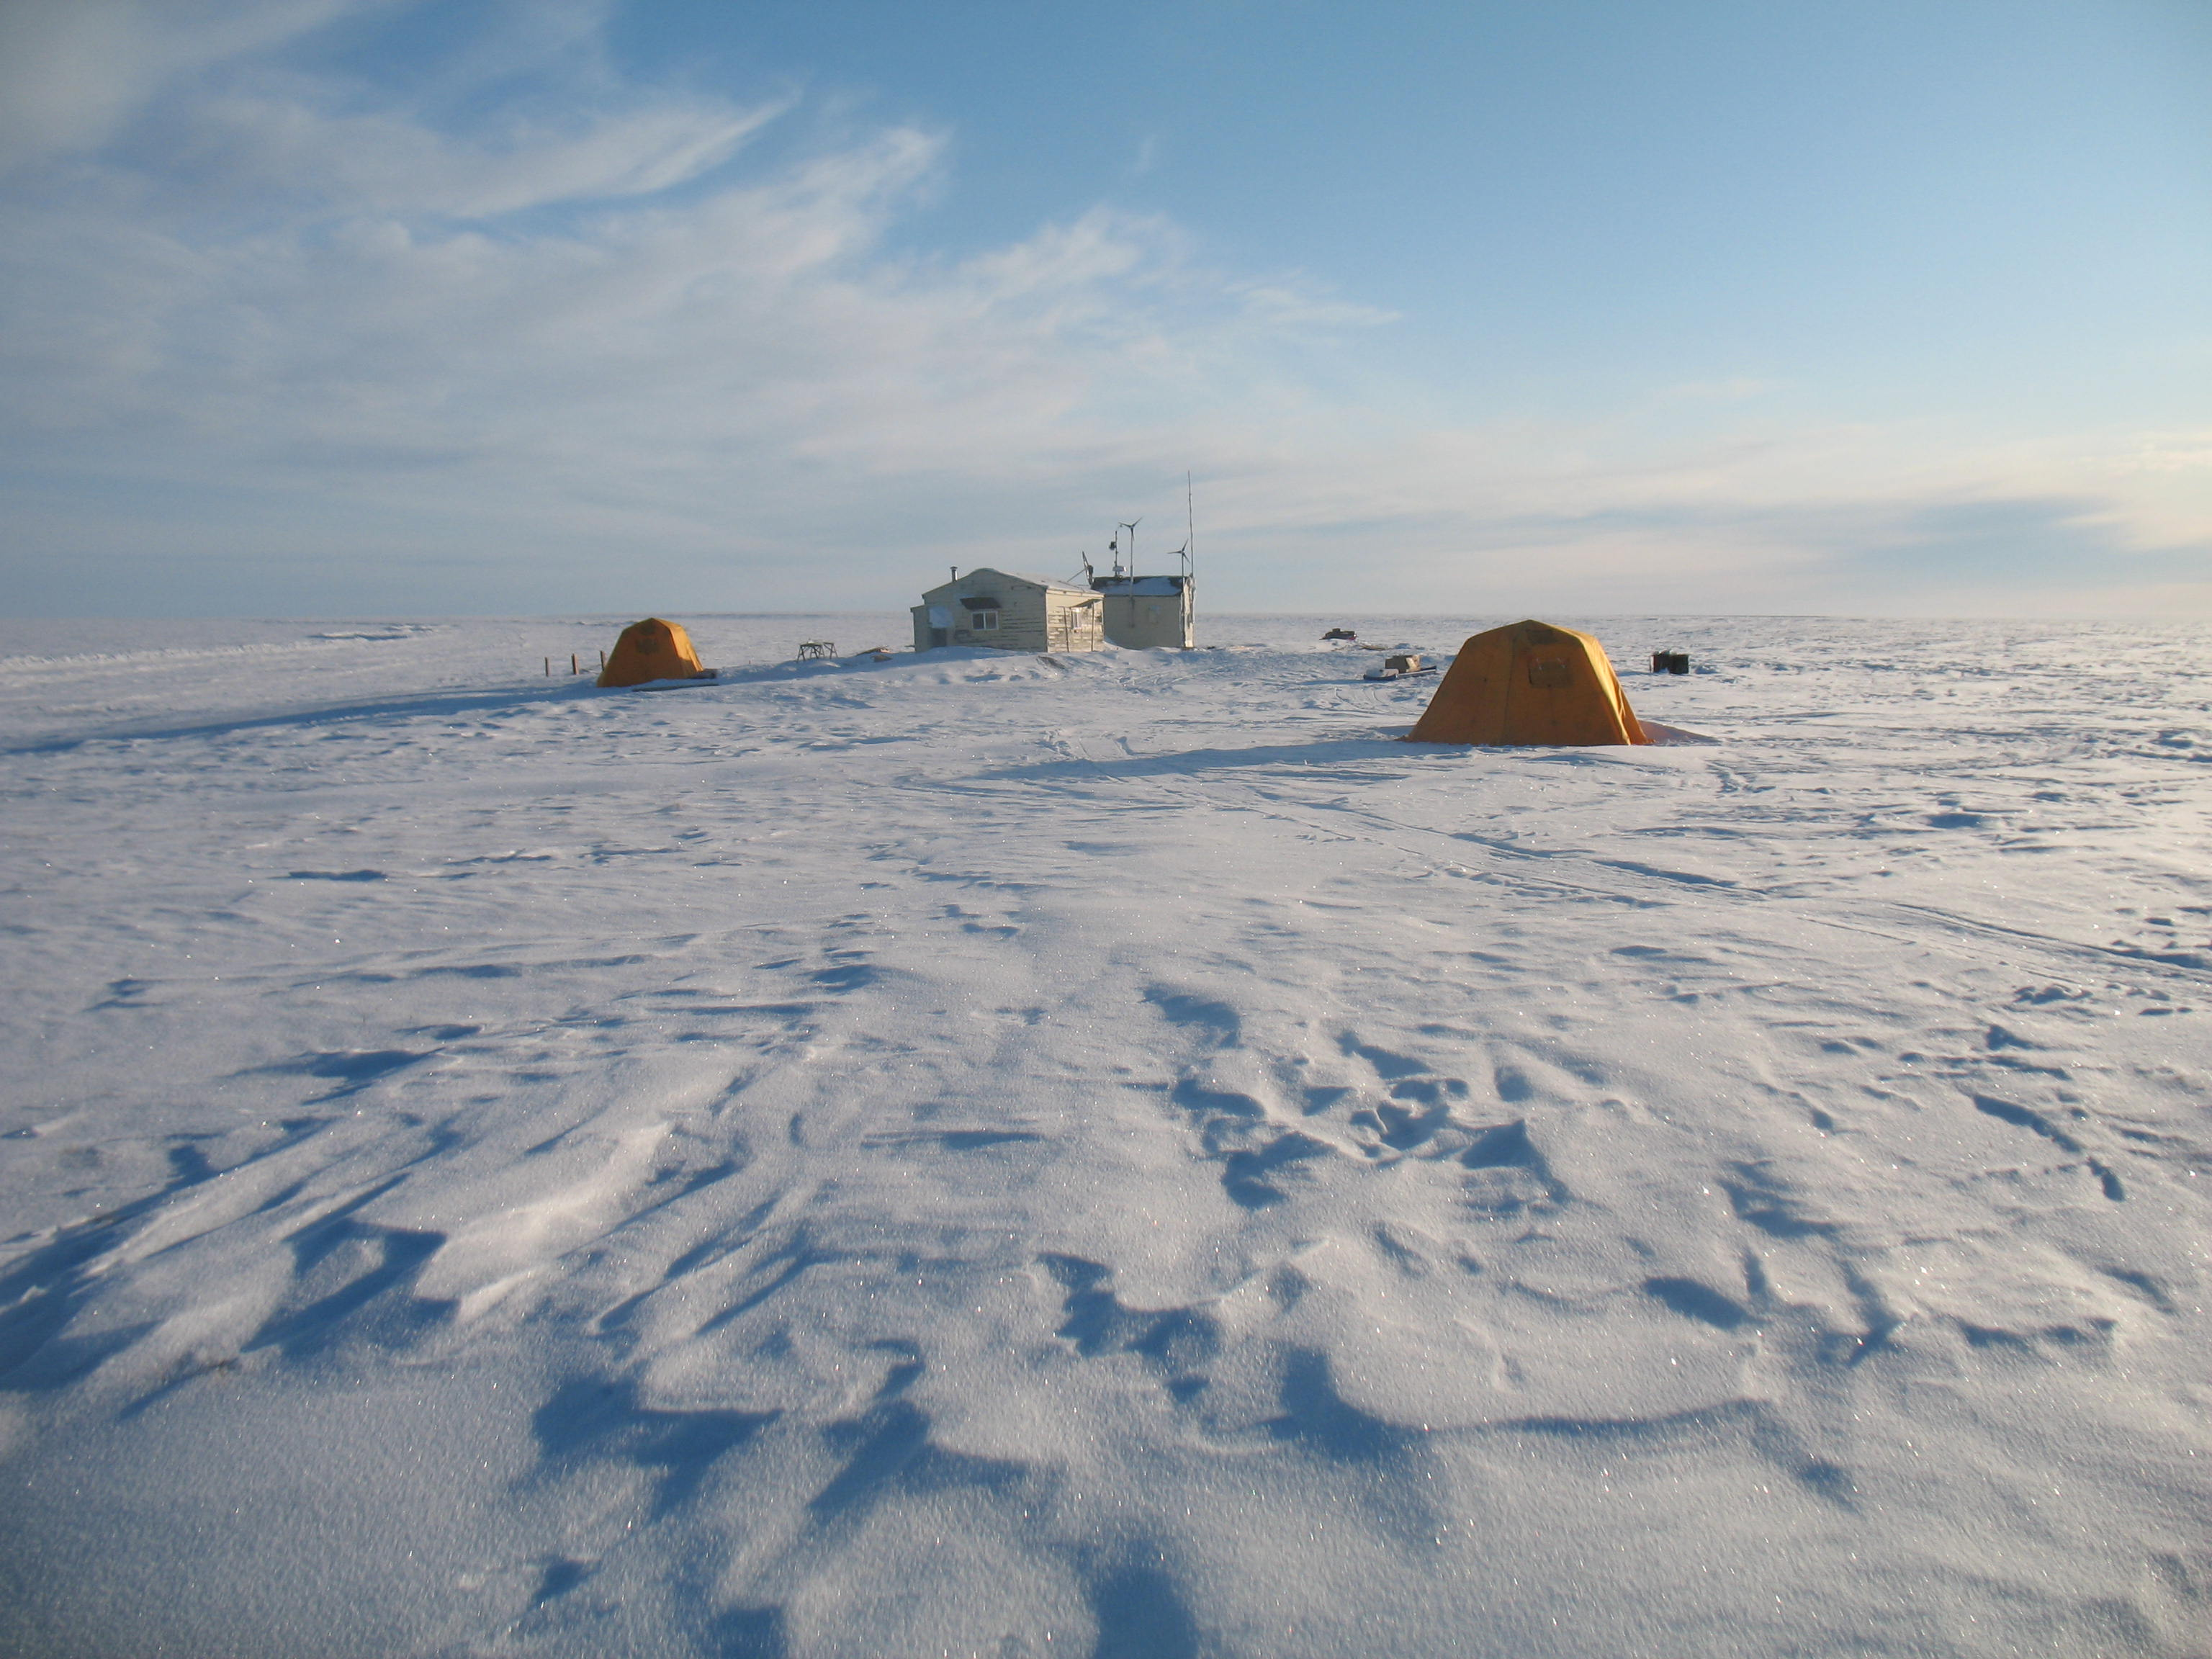
Climate Conditions leading to Short and Long Open-water Periods on Teshekpuk
Notes:
Next I’ll briefly discussed climate conditions of some of these years.

Slide 30
Temperature Regimes of Perennial Ice Cover Years (blue)
vs. Longest Ice-Free Duration Years (red)
Notes:
So what is it about those cold summers that could cause perennial ice cover? No major differences in winter ice growth conditions. Perennial IC years very cold late May – early June, while long IF years have considerable warming in late May. Perennial years have cool late summers, while long IF years are warm and stable into fall.

Slide 31
Closer Look at Average (black), Long (red), and Short (blue) Ice Free Periods
Notes:
Here’s another look. Mostly the difference is just in the ice melt and formation season by temperature and this is exactly what more comprehensive studies of northern lakes have found across large areas and looking at longer records. So looking at climate projections for these periods is likely the obvious way to make future predicitons about tesh ice cover regimes.

Slide 32
Effects of Air Temperature considered major driver of Ice Formation and Decay
Other Drivers of Lake Ice Dynamics
Snow
Wind
Solar Radiation
Lake morphometry

Slide 33
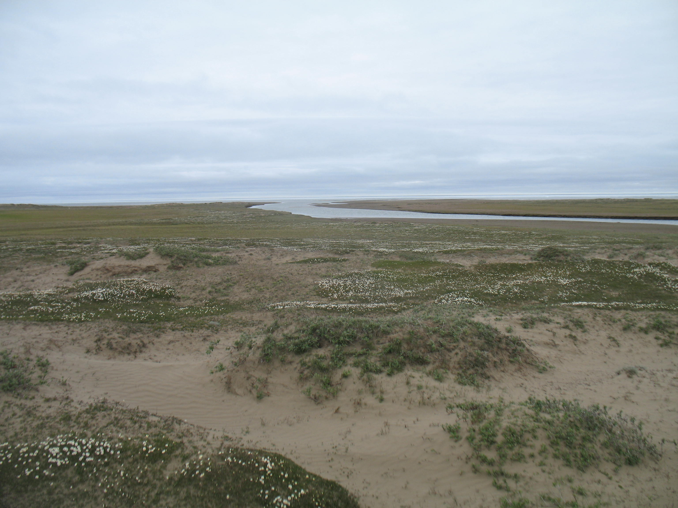
Impact of Ice-cover on Hydrology
Notes:
I’ll just present a few slide on implication for hydrology and leave it at that.

Slide 34
The role of Ice Cover and Dynamics on Lake Hydrology and other Processes
Notes:
We calcuated lake evaporation for open-water periods and maybe not surprisingly there’s a close relationship between these and suggests greater evaporative losses.

Slide 35
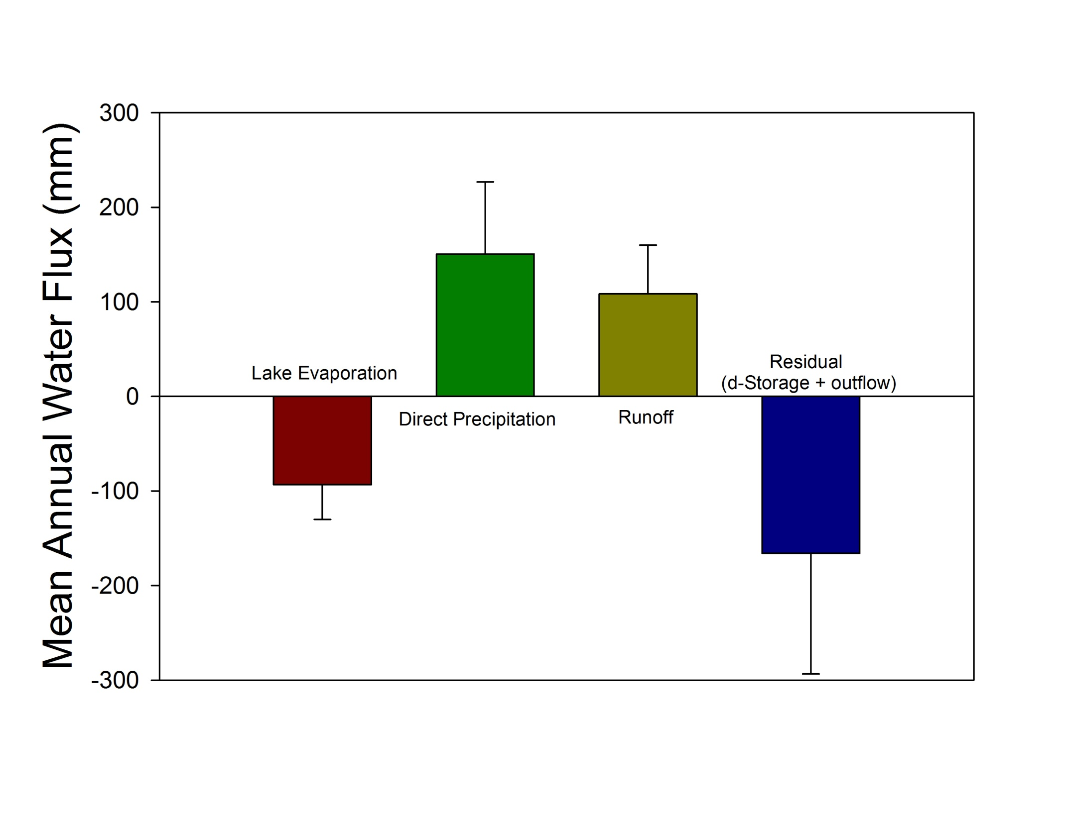
Rough Estimate of Teshekpuk Lake Water Balance (1977 – 2008)
Notes:
Here’s rough estimate of water budget for Teshekpuk Lake showing that it likely recieves most water from direct snow and rainfall onto lake and runoff input is roughly balanced by evaporation. If you use these estimates to calculate mean residence time you get something like 10-15 yrs to recharge the lake. Haven’t made many calculations like that for large thermokarst lakes, but interesting to consider.

Slide 36
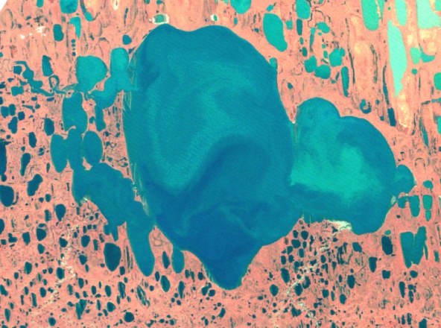
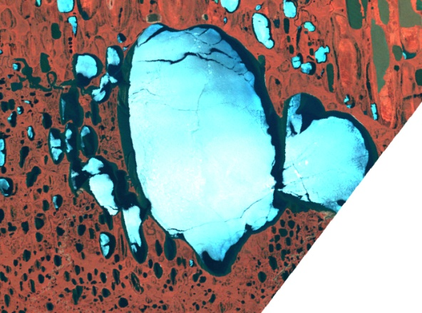
Teshekpuk Lake - Ice jams, wind, and outflow
Notes:
But the hydrology is likely much more complicated for very large lake like Tesh. This shows one year when USGS monitored lake levels and this spike likely corresponds to ice out and potentially ice jamming the outlet, wind causing higher water levels, or both.

Slide 37
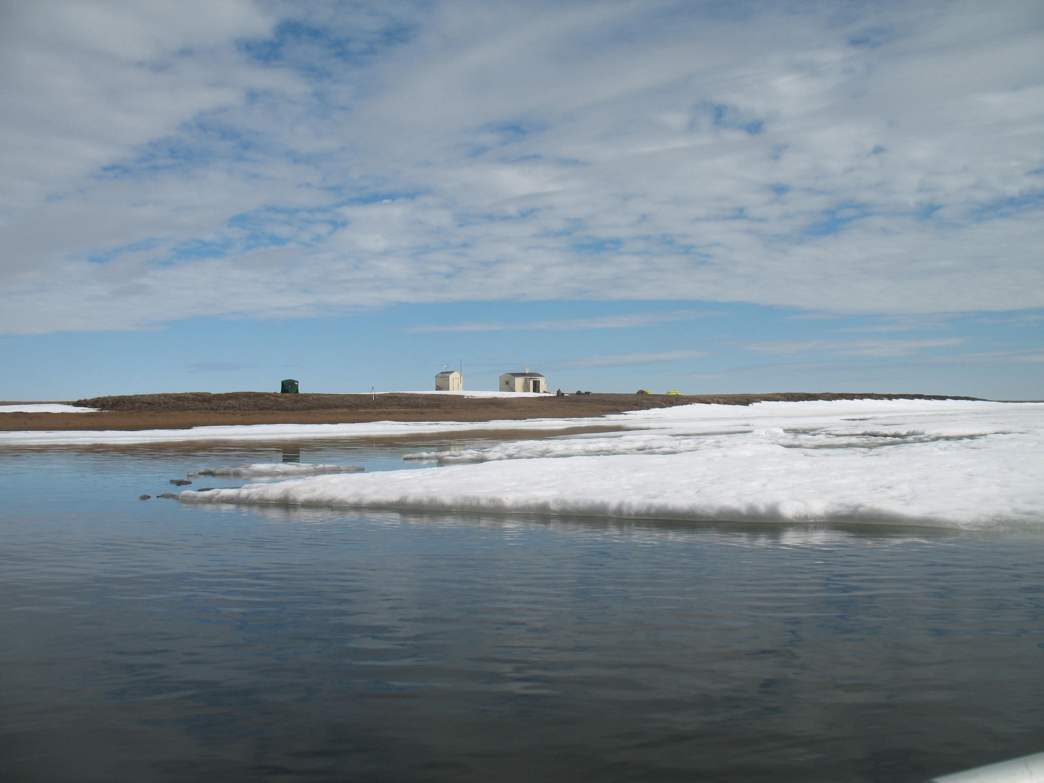
Toward the Teshekpuk Lake Observatory
Notes:
It would be great to start collecting data to accurately quantify these aspects of Tesh and integrate them with ecological understanding. Currently we have to proposals in to improve monitoring and research infrastructure on Teshekpuk, so if successful expect to see more interesting results.

Slide 38
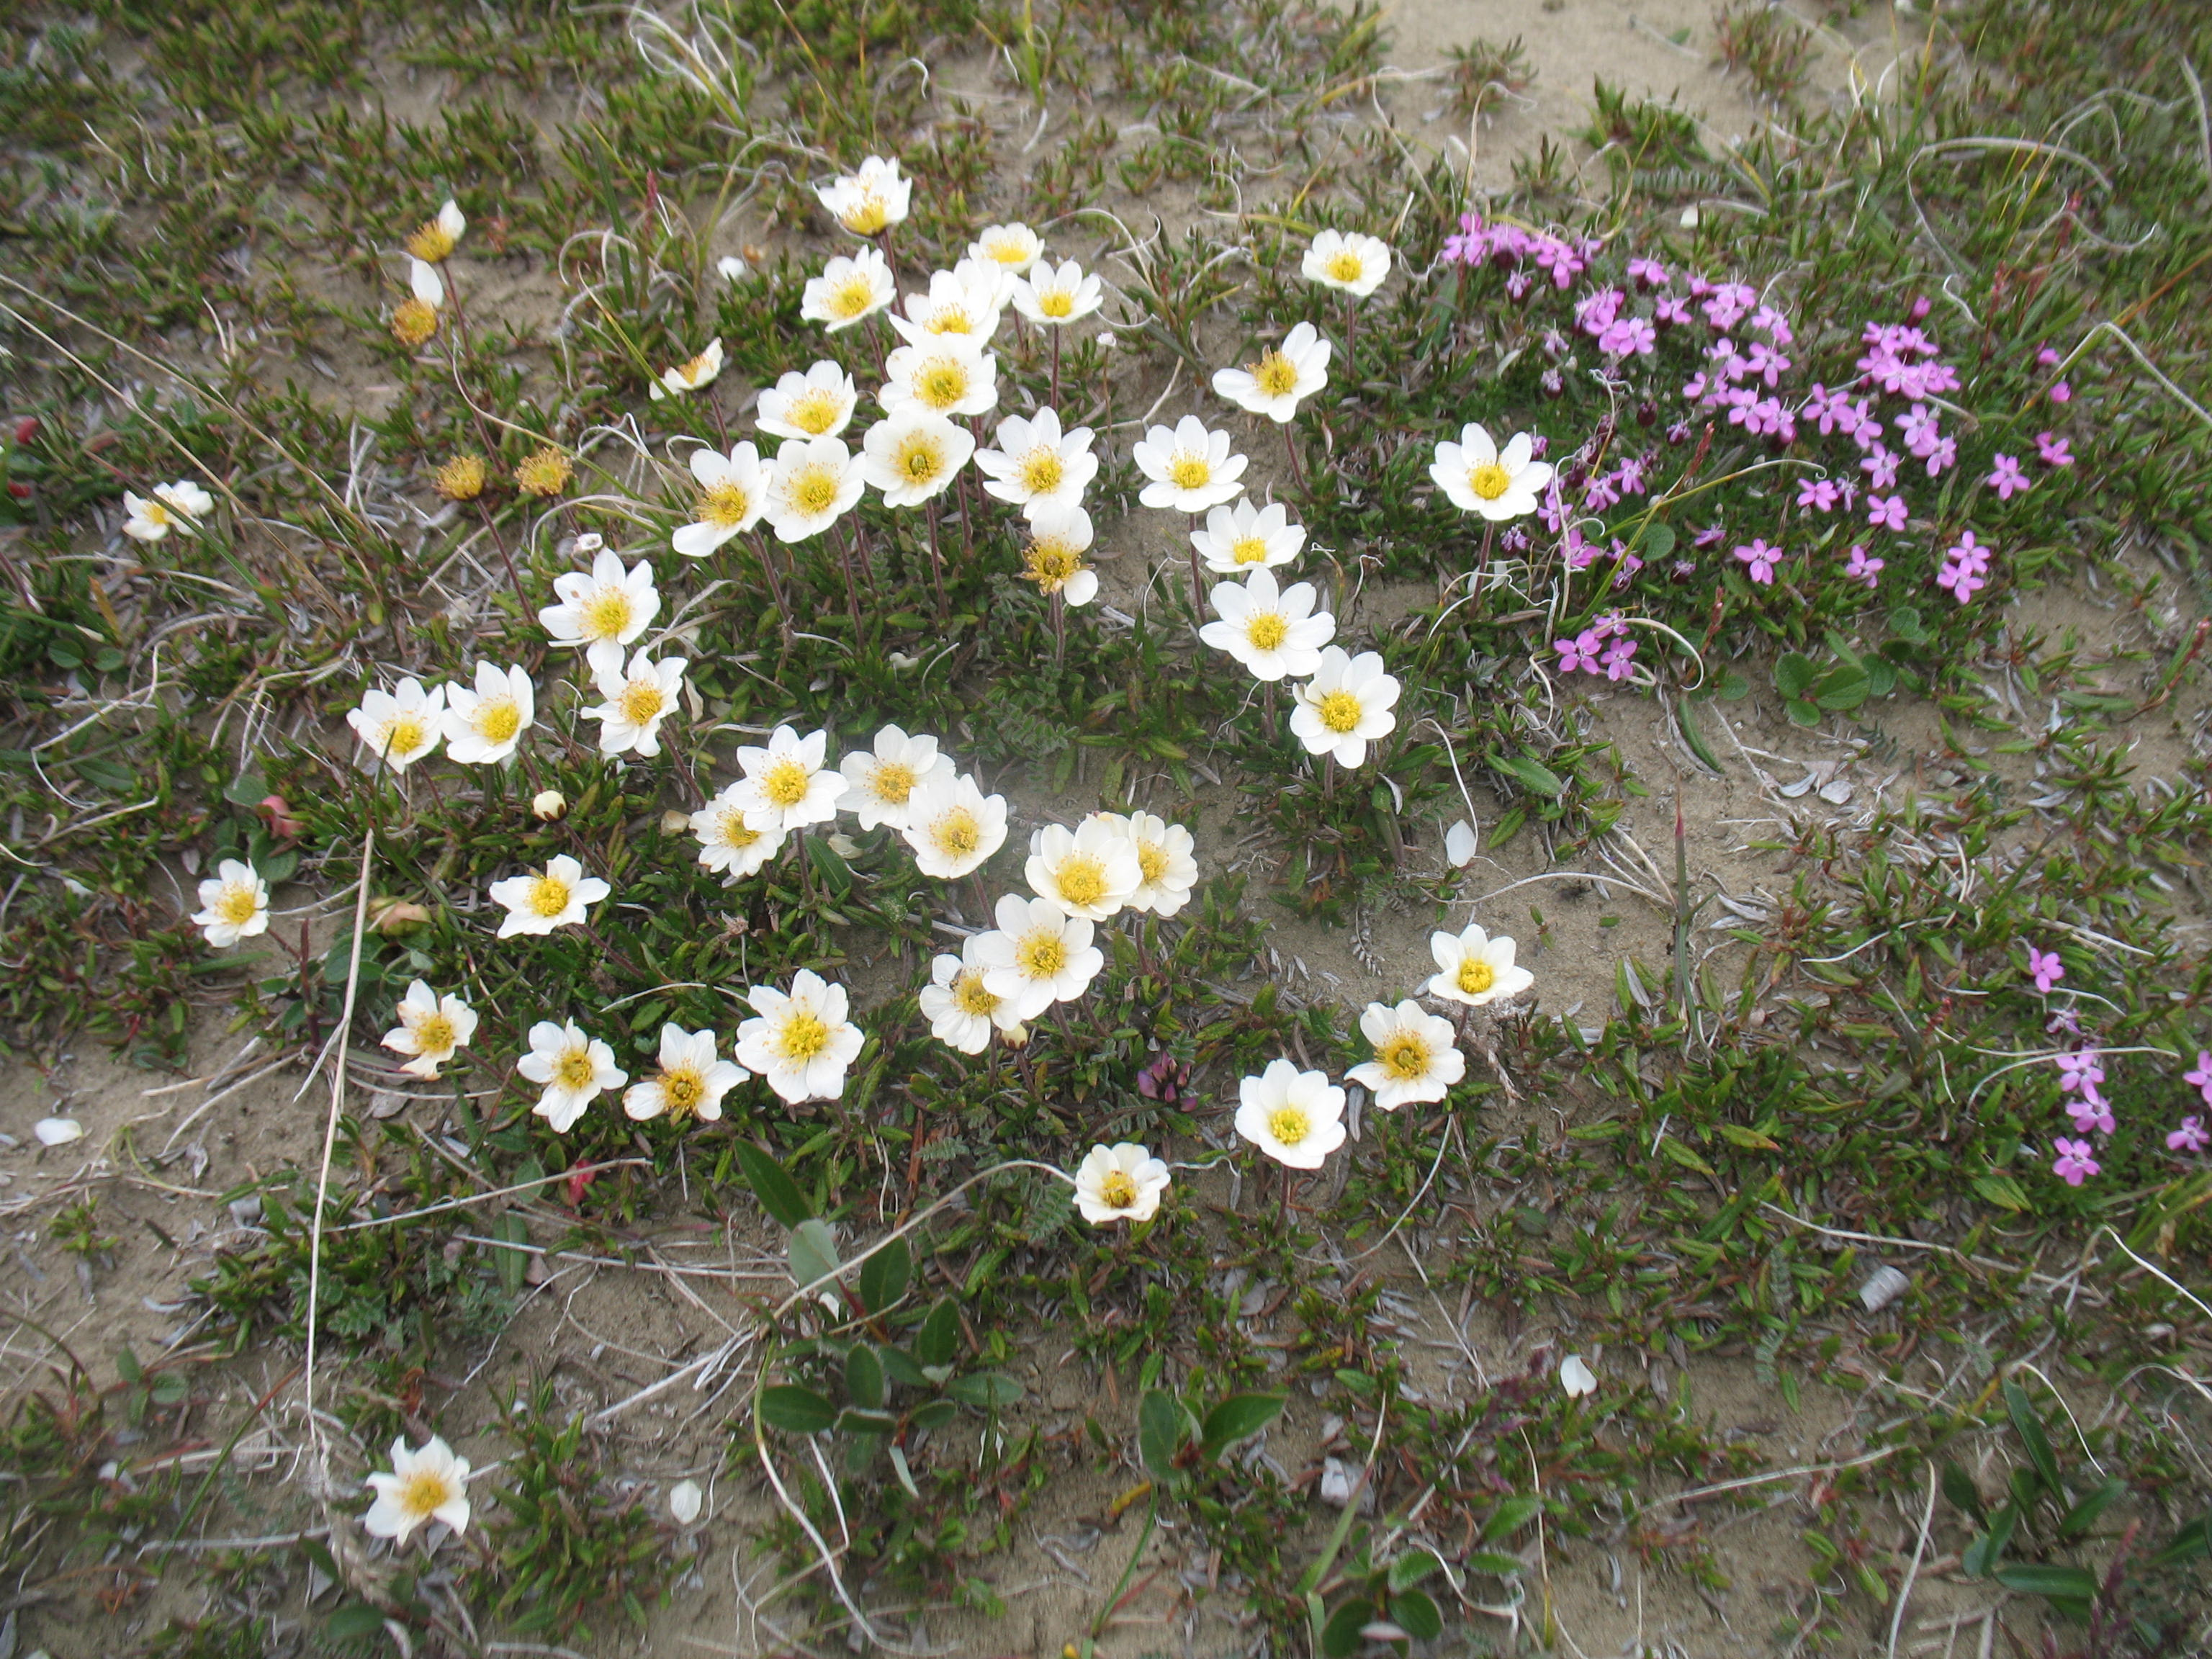
Conclusions
Notes:
I’m out of time, but thanks for listening to me ramble on about one of my favorite places.

Slide 39
Geomorphic Processes – Thermokarst Erosion
Increasing Lake Expansion
Deeper lakes have higher erosion rates
Deeper lakes are warmer with greater potential for thermal erosion
Arp et al 2011 Hydrological Processes
Notes:
We compared lake shorelines between 1979 and 2002 and found rates ranging from no change in shallowest lakes up to 1.8 m/yr in deeper lakes with floating ice regimes and we think a major mechanism is warmer water in deeper lakes and its impact on thermal erosion of ice rice permafrost shorelines.

Slide 40
Hydrologic Processes – Water Balance
Deep lake with late (July)
ice-out
Shallow lake with early (June)
ice-out
Increasing Variation in Lake Surface Area
Very shallow lake with very early (May)
ice-out
Arp et al 2011 Hydrological Processes
Notes:
By standardizing annual measurements of lake water surface area with landsat by erosion rates we were able to make better comparisons of interannual variation due to changes in lake water balance. This set of graphs shows that surface area was most variable in the shallowest lakes and very stable in deeper lakes with floating ice regimes from 1974-2008. Part of this variation may be related to when ice out occurs. For example in 2008, this deeper lake ice out was in early July, shallow lake with bedfast ice in mid-June, and very shallow lake in late May. Recall that this is during short period when evaporation can occur from lake surfaces and only when ice free.

Slide 42
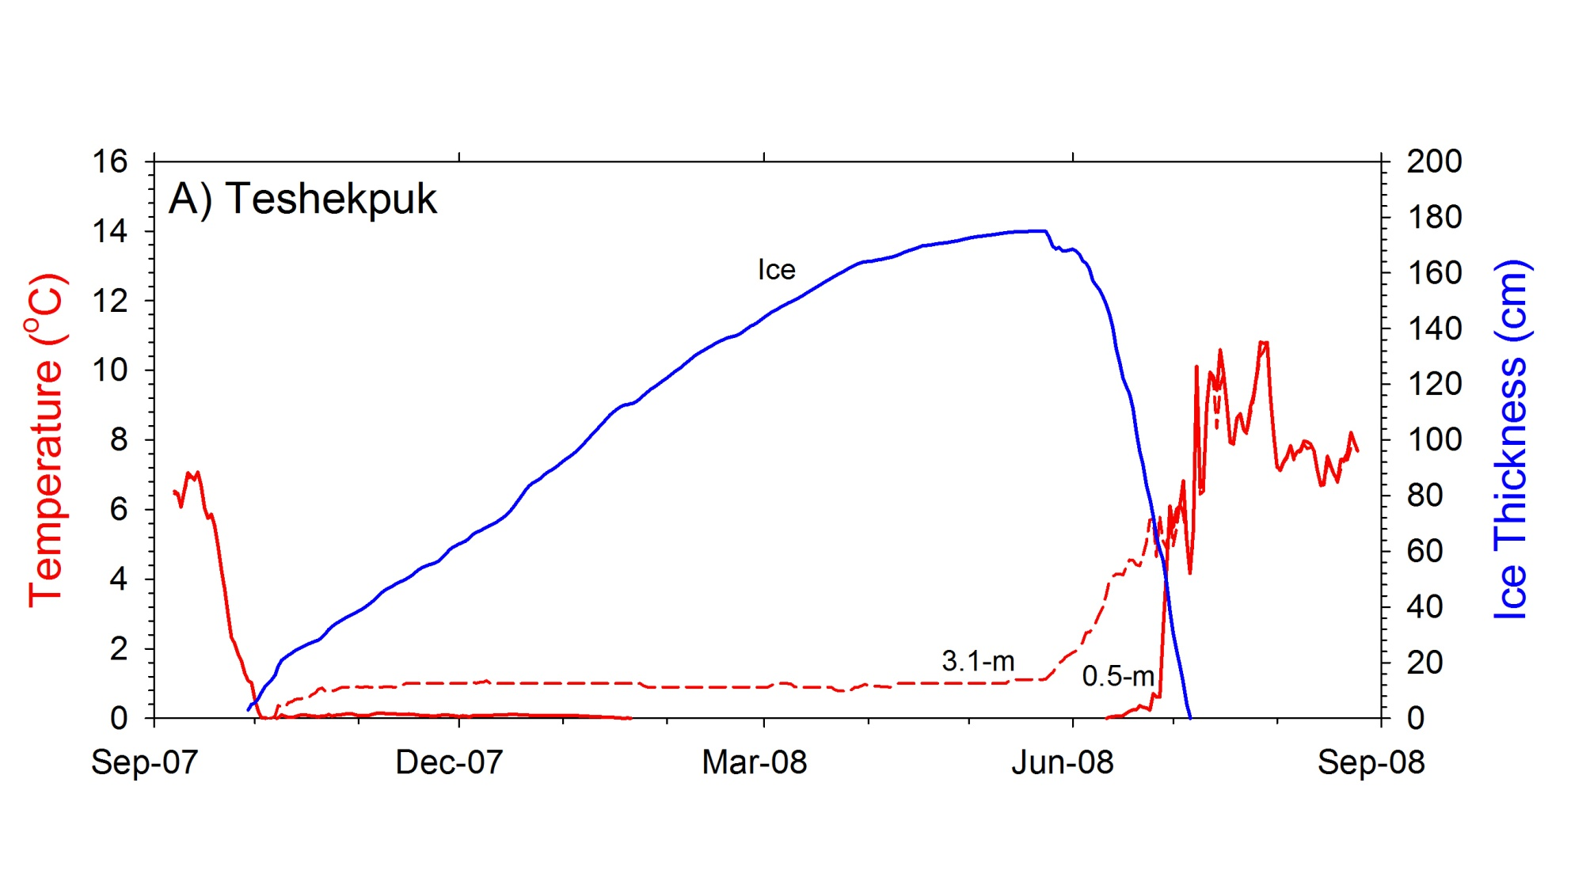

Slide 43
